Slide 1
Remote Controlled Greenhouse – Assembly Instructions

Slide 2
Packout Assembly

Slide 3
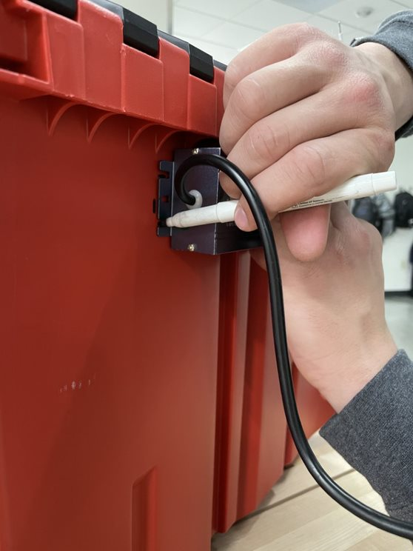
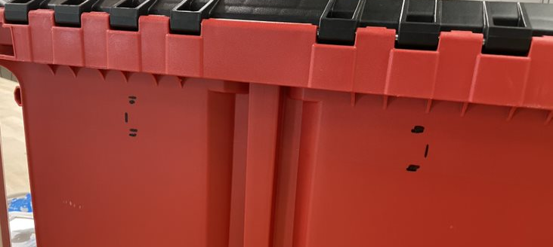
Mounting Transformer
Hold up transformer to approximately the middle top of the backside of the packout and mark where to drill holes.

Slide 4
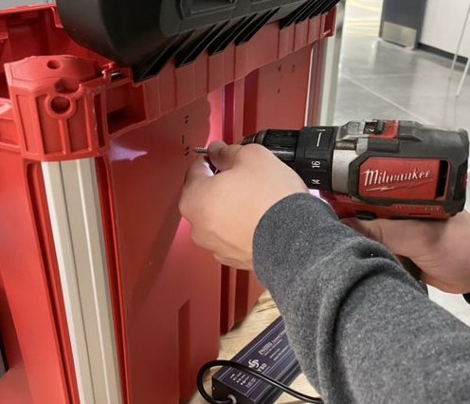
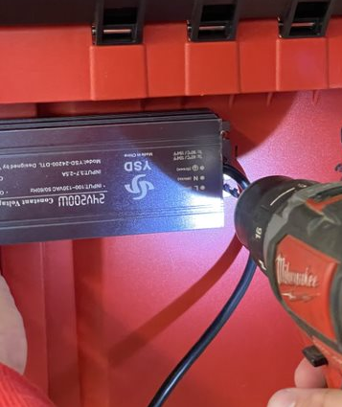
Mounting Transformer
Grab your 1/8 “ drill bit and drill through the packout.
Grab your #6-32 bolt, washer and nut and secure the transformer to the packout.

Slide 5
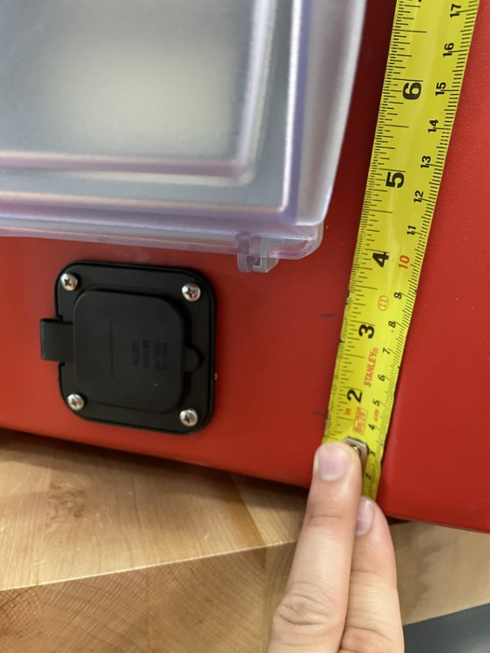
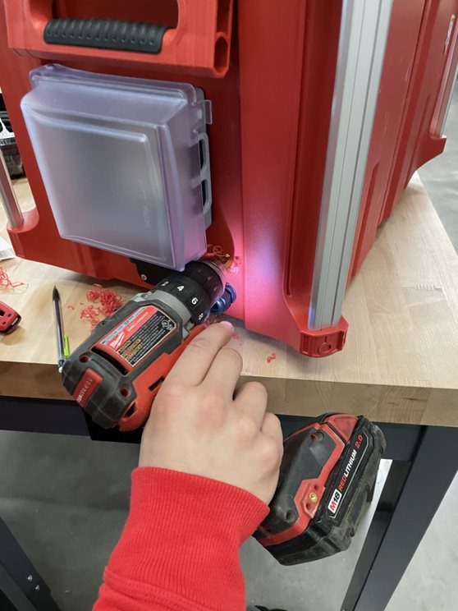
Grommets
Measure 1-1/2 inches and 3 inches from the bottom of the packout towards the backside.
Drill a 7/8 hole at the measured marks with your stepper drill bit.
Do this on both sides of the packout

Slide 6
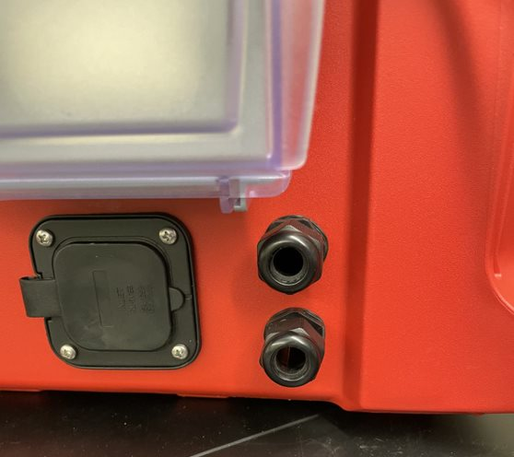
Grommets
Insert and tighten ½”NPT grommets everywhere.

Slide 7
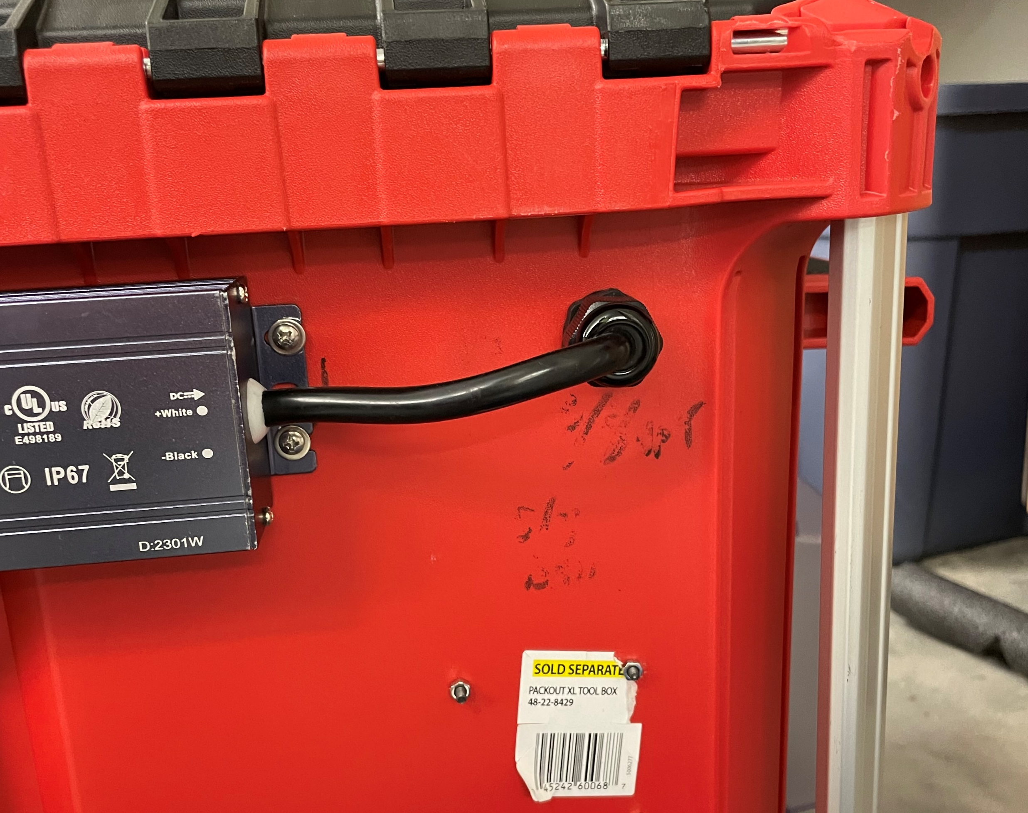
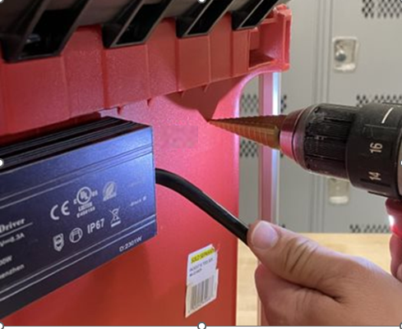
Power supply
Drill a 5/8 hole a few inches away from the transformer to allow for the wire to bend enough to go in the grommet.
Insert a 3/8 NPT and secure.

Slide 8
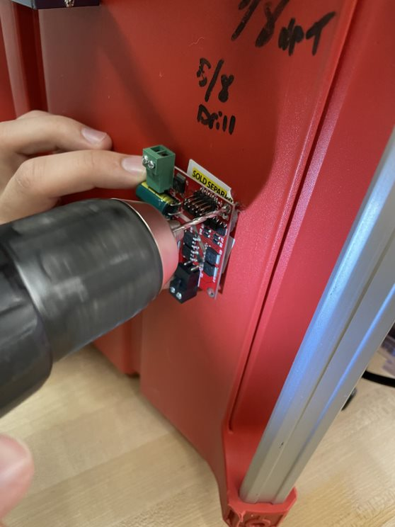
Motor Driver Reply
Drill pilot holes on the outside of the packout for the relay driver.(easier than drilling on the inside)

Slide 9
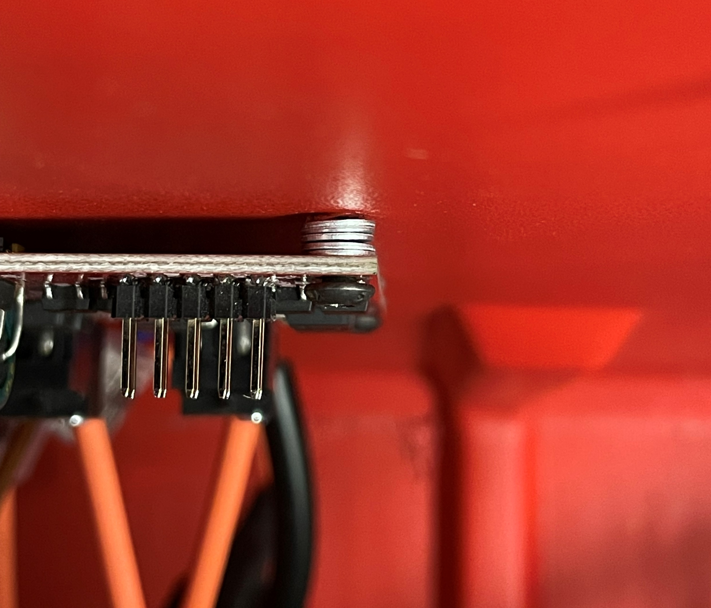
Motor Driver Reply
Place 4 3m washers between the relay driver and the inside of the packout.
Secure with 3mm bolts and nuts

Slide 10
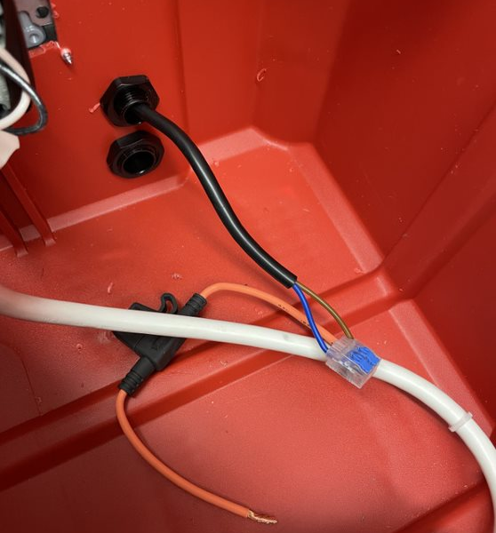
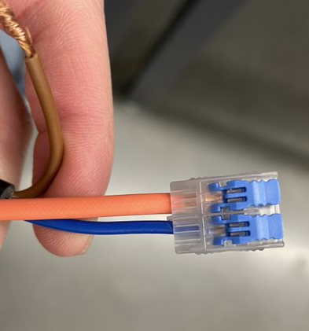
Wire connectors
Insert the motor wires through the top grommets on the sides.
Connect the fuse holder and blue wire with the snap connectors

Slide 11
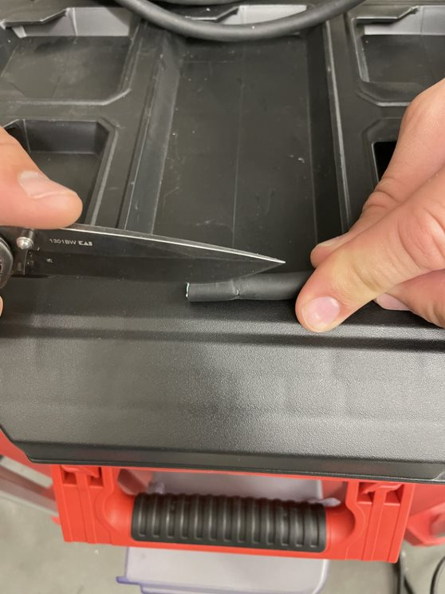
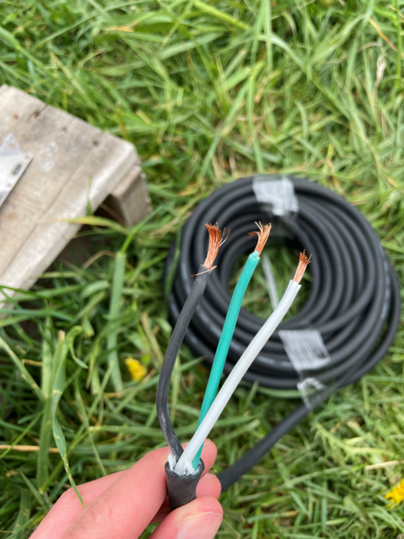
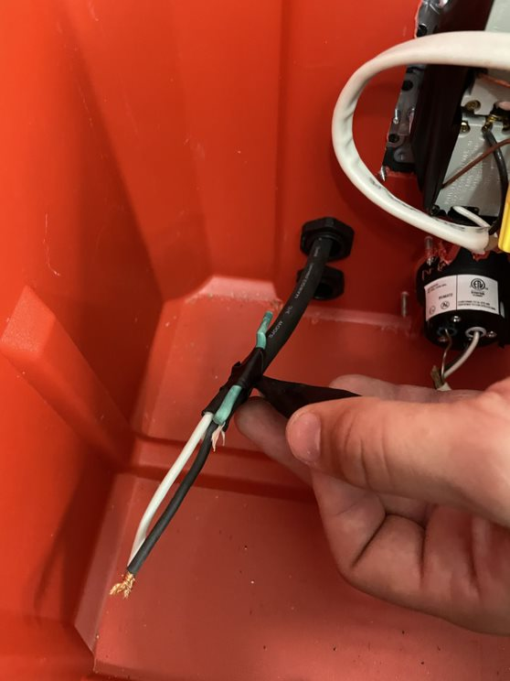
Extending motor wire
Extend the motor wire by striping the 3 wire 14 gauge cord
Strip the outside coating about 4 inch long
Strip the black and white coating about a quarter of an inch.
Run the wire into the packout and then bend the green wire and tape it out of the way

Slide 12
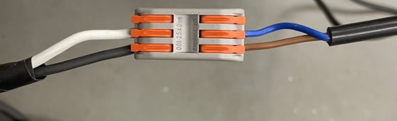
Connecting extended wire to motor.
Connect the white wire to the blue wire in the snap connector
Connect the black wire to the brown wire in the snap connector
Fuse wire holder will connect to the white wire then.(look on wire connecting slide to continue)

Slide 13
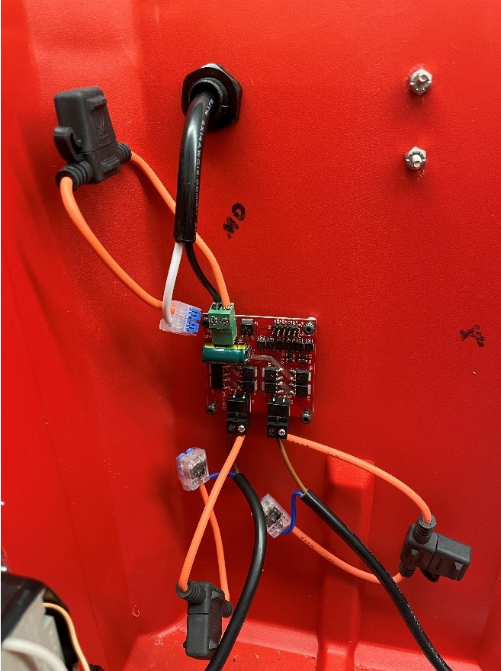
Wire connectors
Insert the transformer wire through the grommet
Connect the fuse holder and the white wire with a snap connecter.
Place the white Color of the transformer in the positive slot of the relay driver and the black wire of the transformer in the negative slot.
Place the brown/black wire of the motor in the left slot of the relay driver and the blue/white/fuse wire of the motor in the right slot of both p3 and p4 outs.

Slide 14
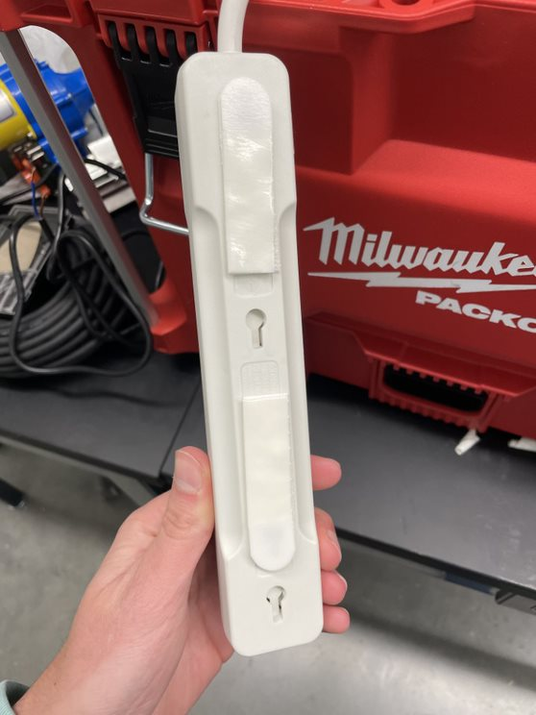
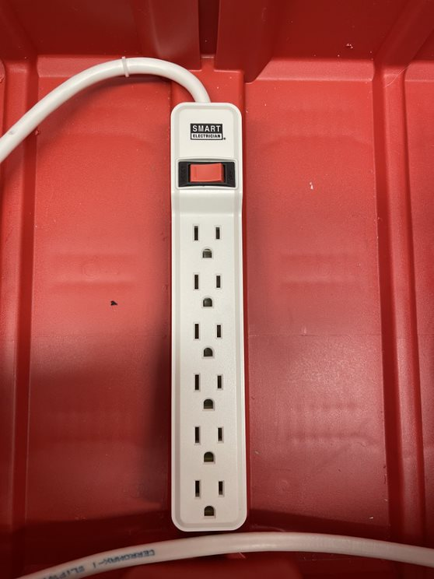
Power Strip
Place Velcro command strips on the back of the power strip and on the bottom of the pack out on the ridge in the middle.

Slide 15
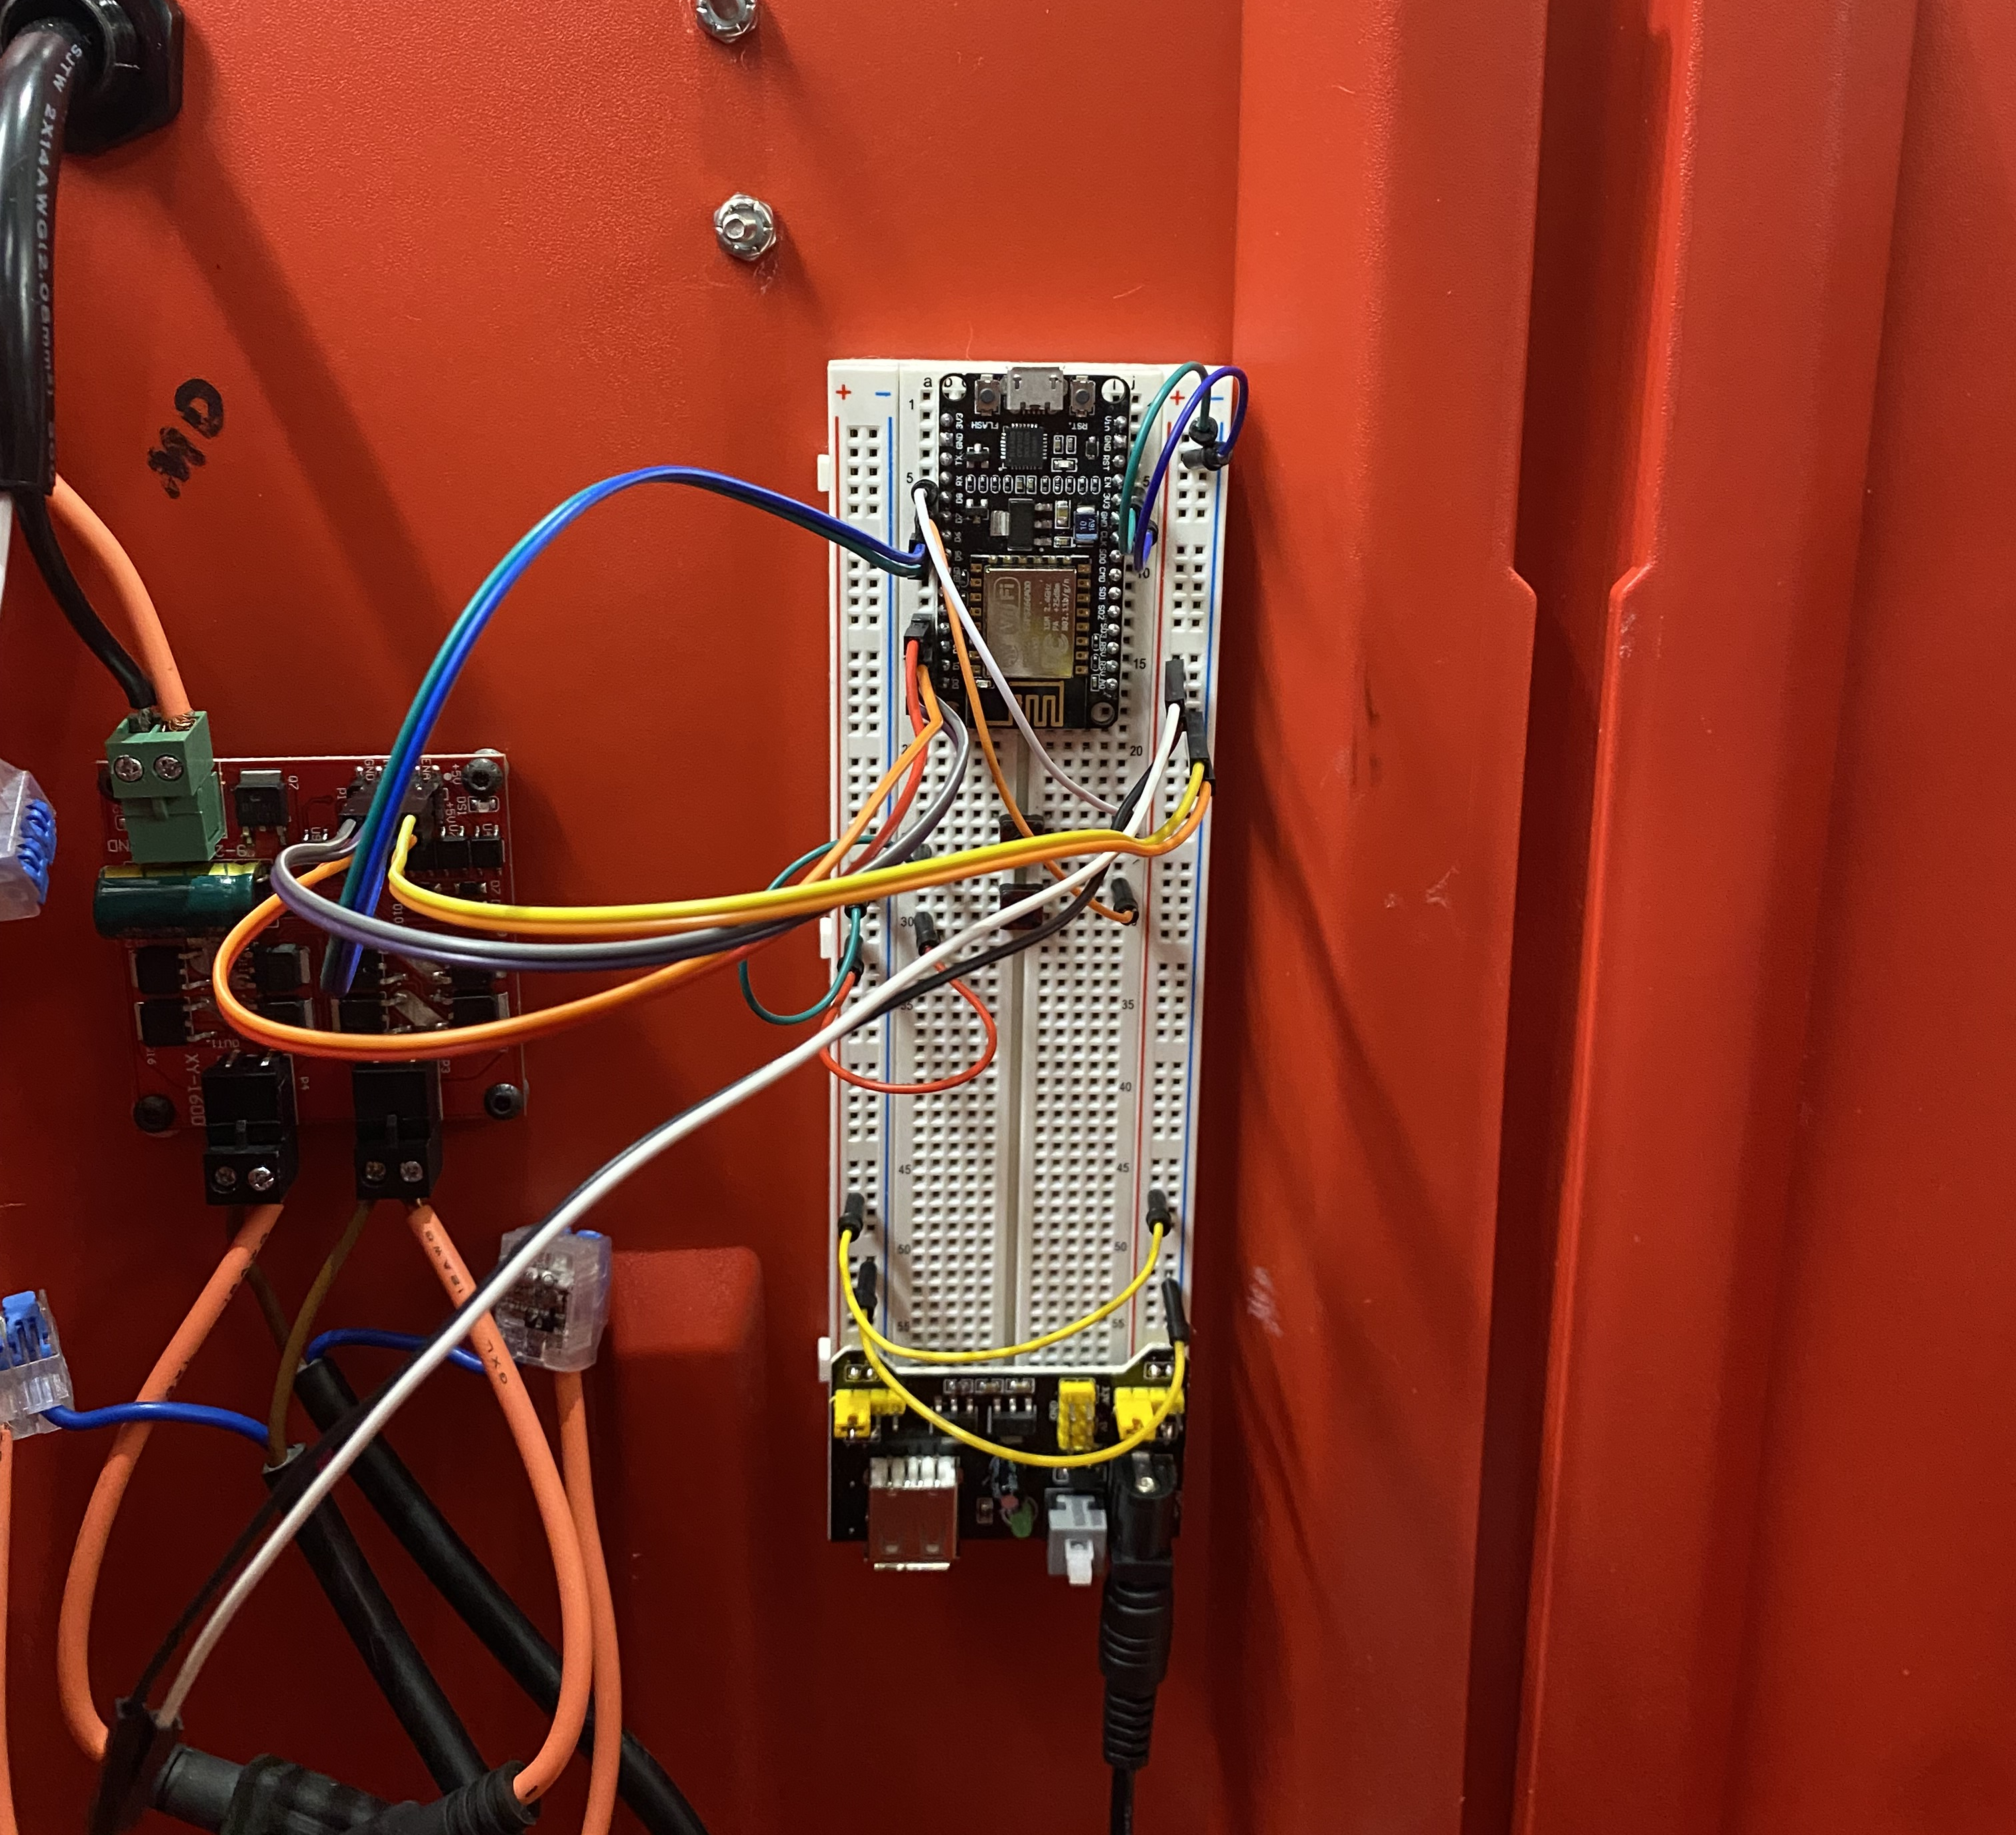
Mounting Arduino to Packout

Slide 16
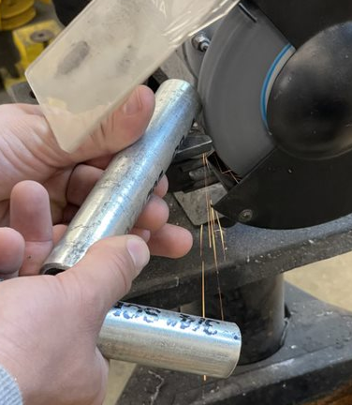
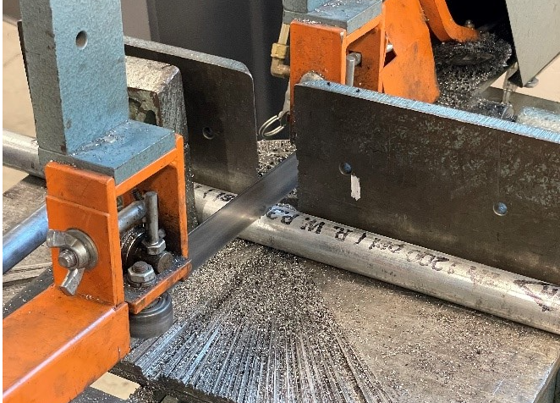
Pipe cutting
Cut the ¾” diameter pipe to the desired length for the creeper to travel on. (Recommended around 6 feet, but may be different size depending on greenhouse set up)
Cut the excess ¾ “ pipe again for the connector piece between the motor coupler and curtain rod.(recommend cut of 5 inches and you can go down from there if you want less space between the curtain rod and your motor coupler.

Slide 17
Arduino Wiring and Operation

Slide 18
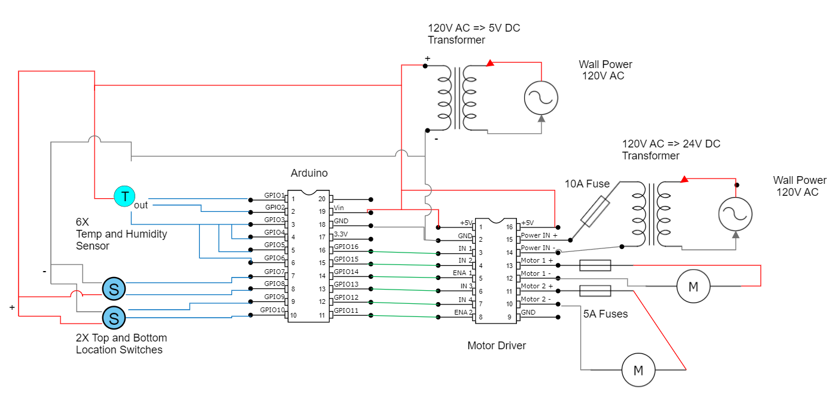
Wiring diagram

Slide 19
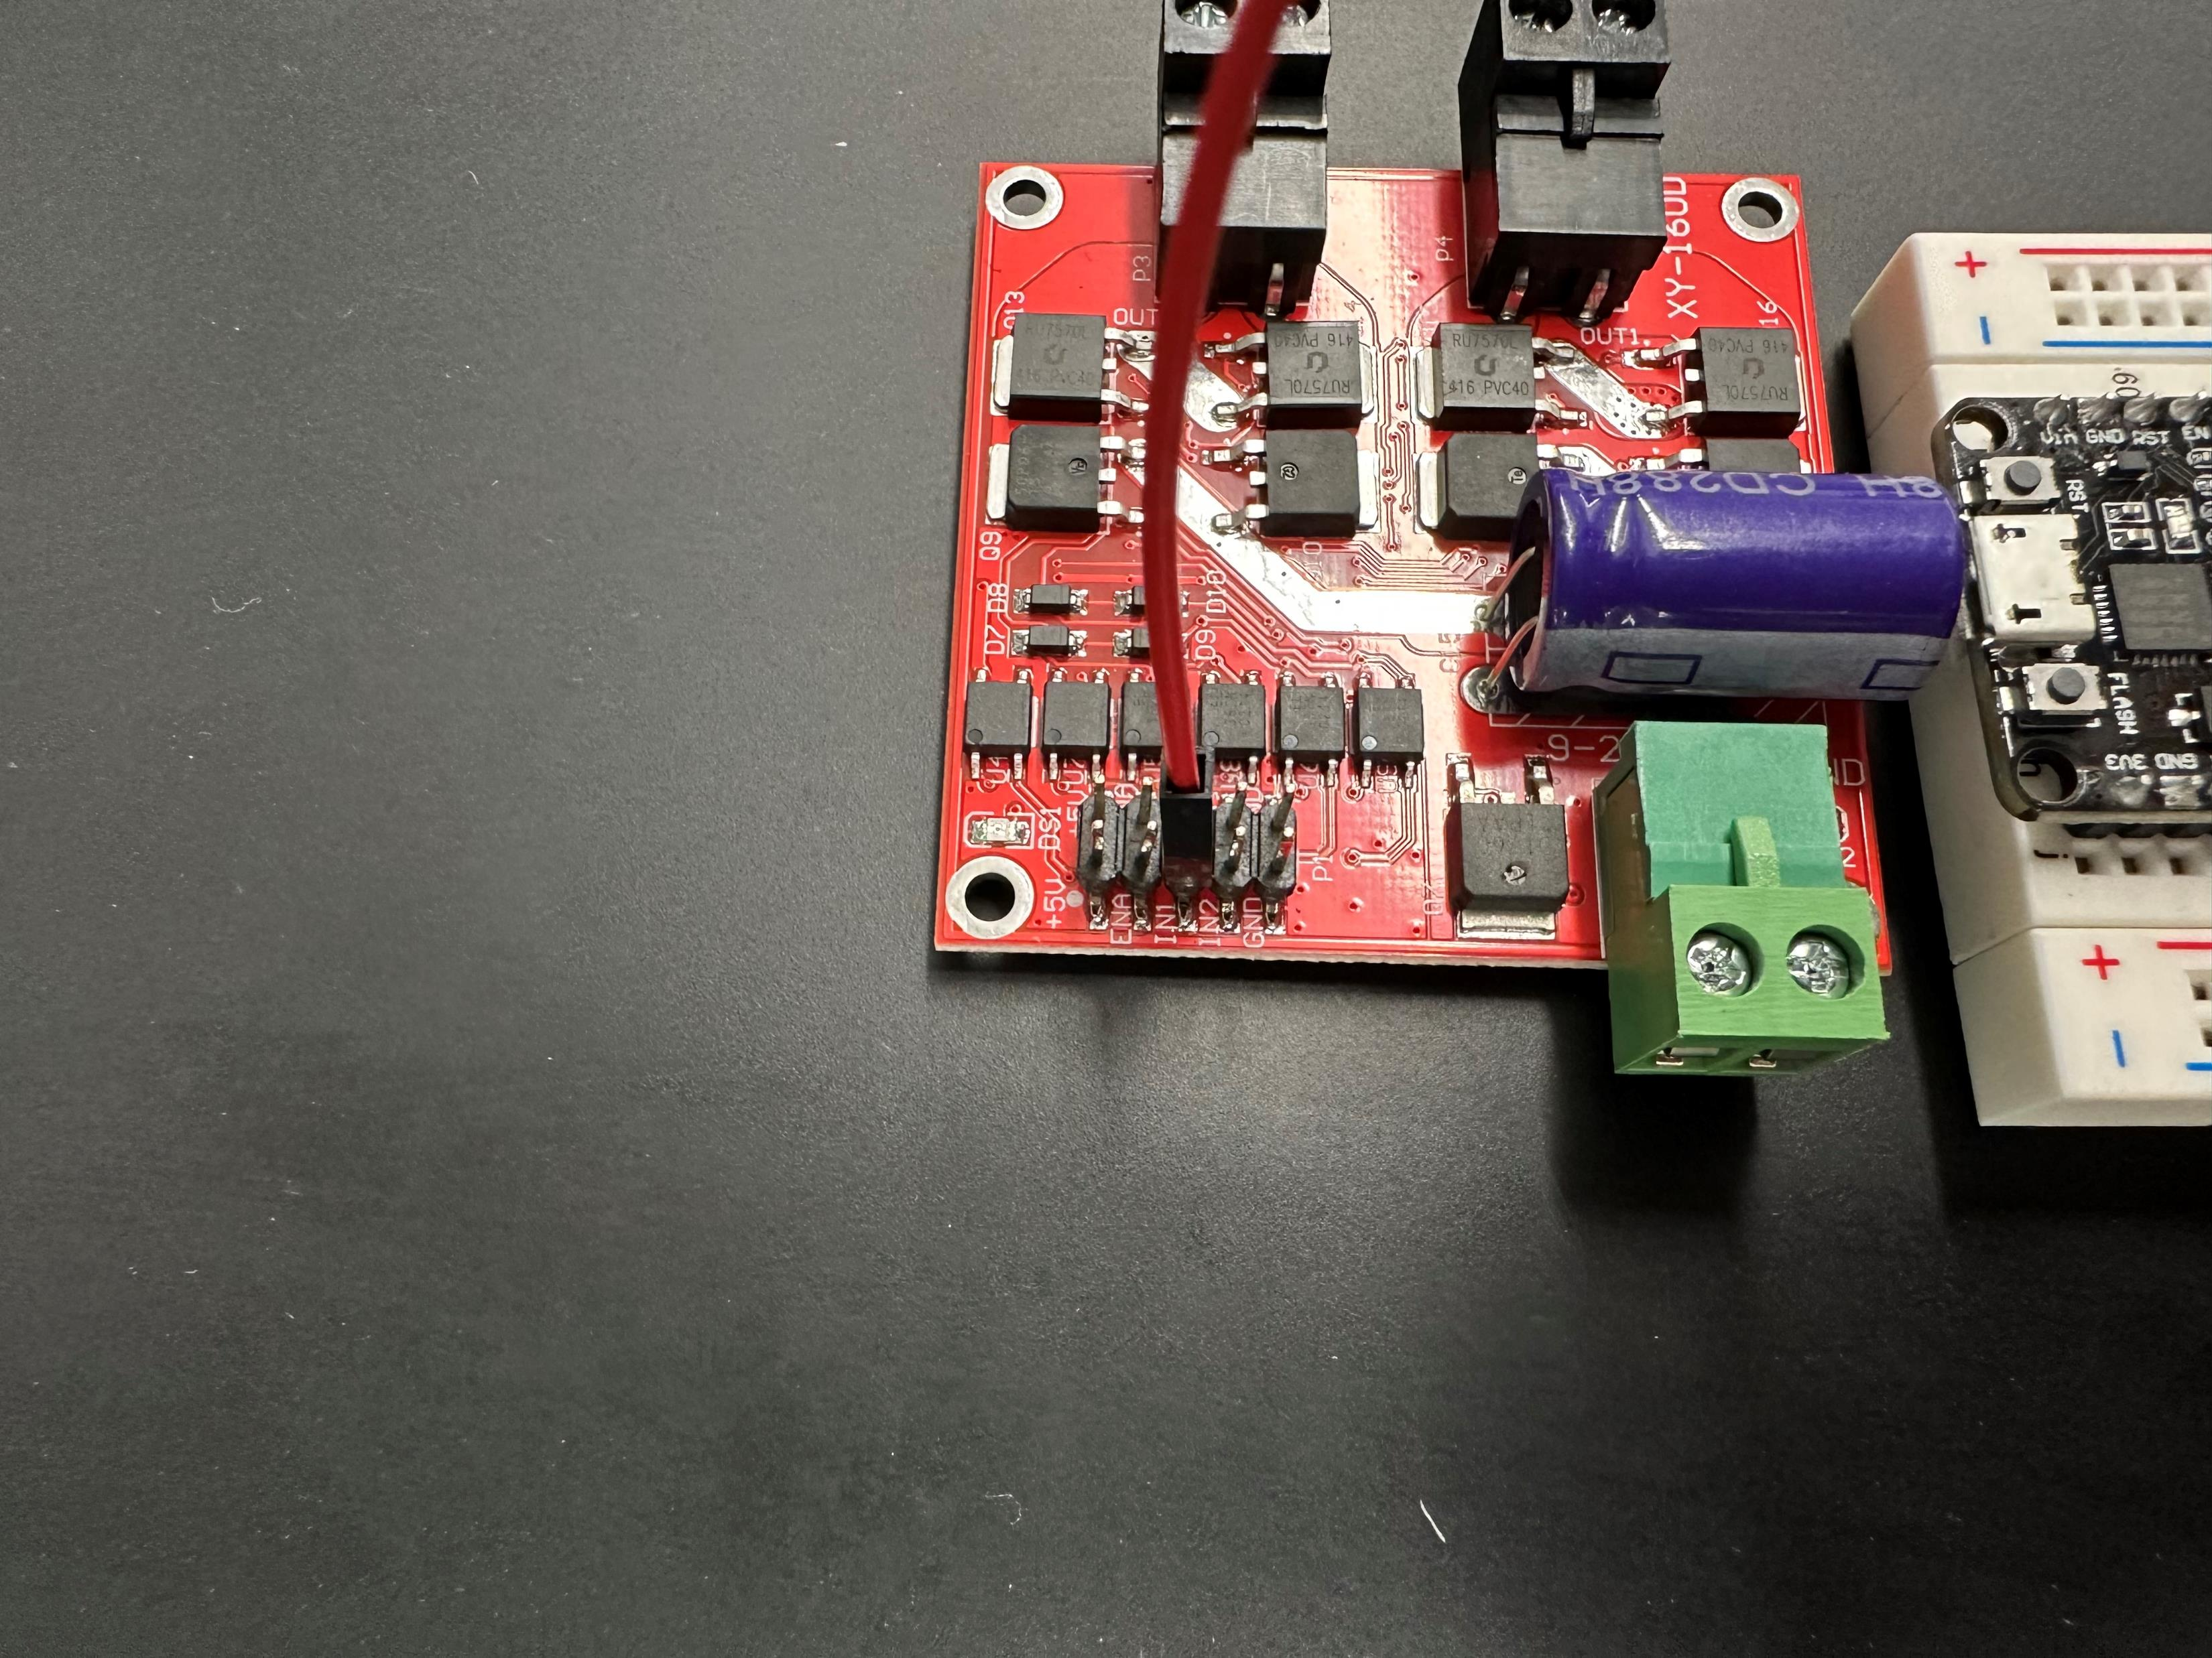
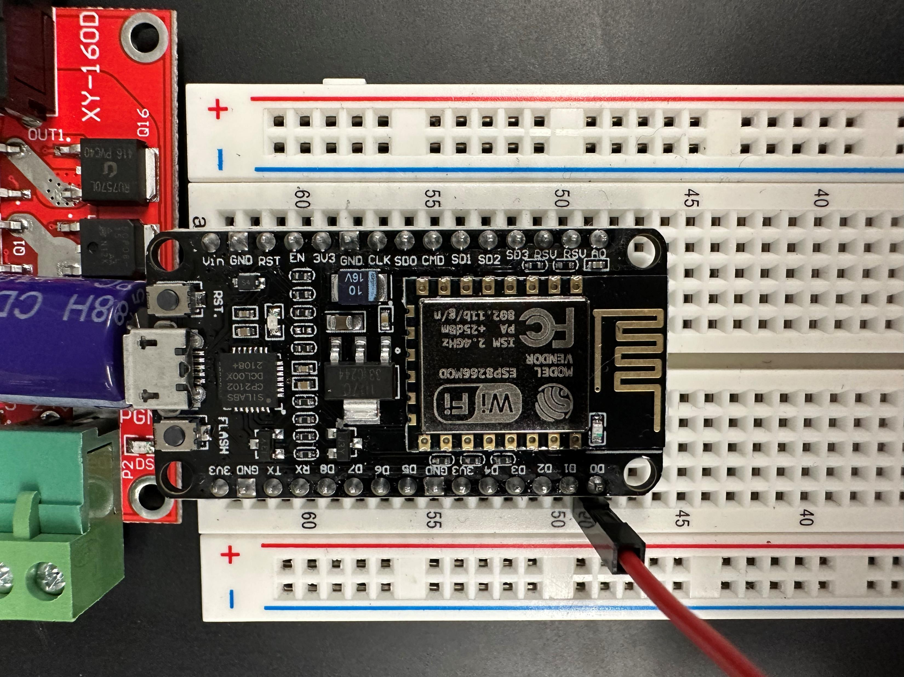
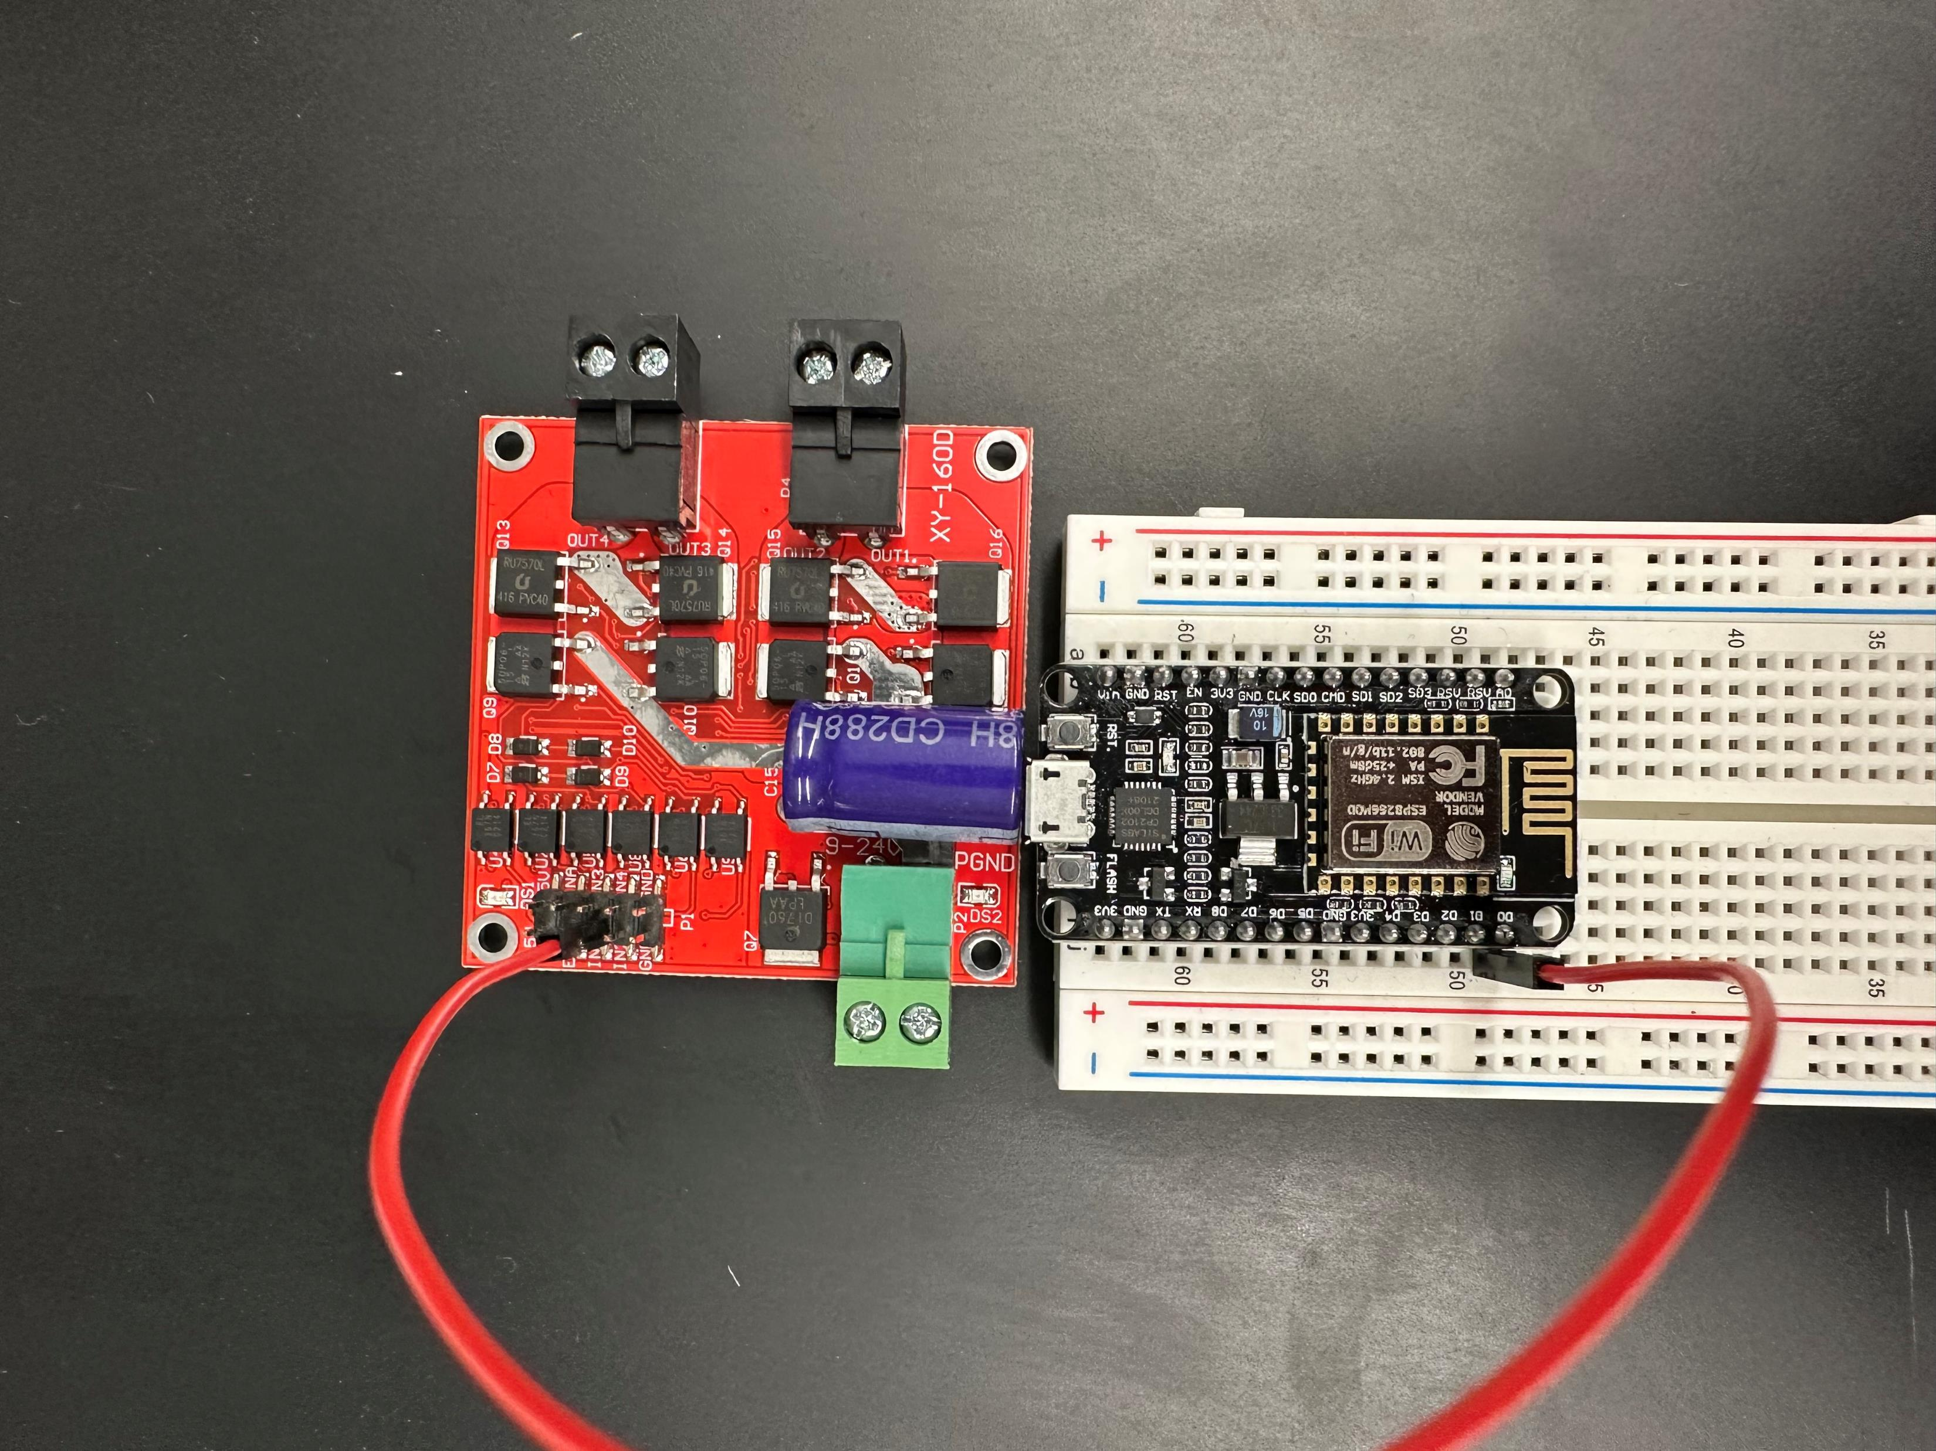
Pin D0 to IN1

Slide 20
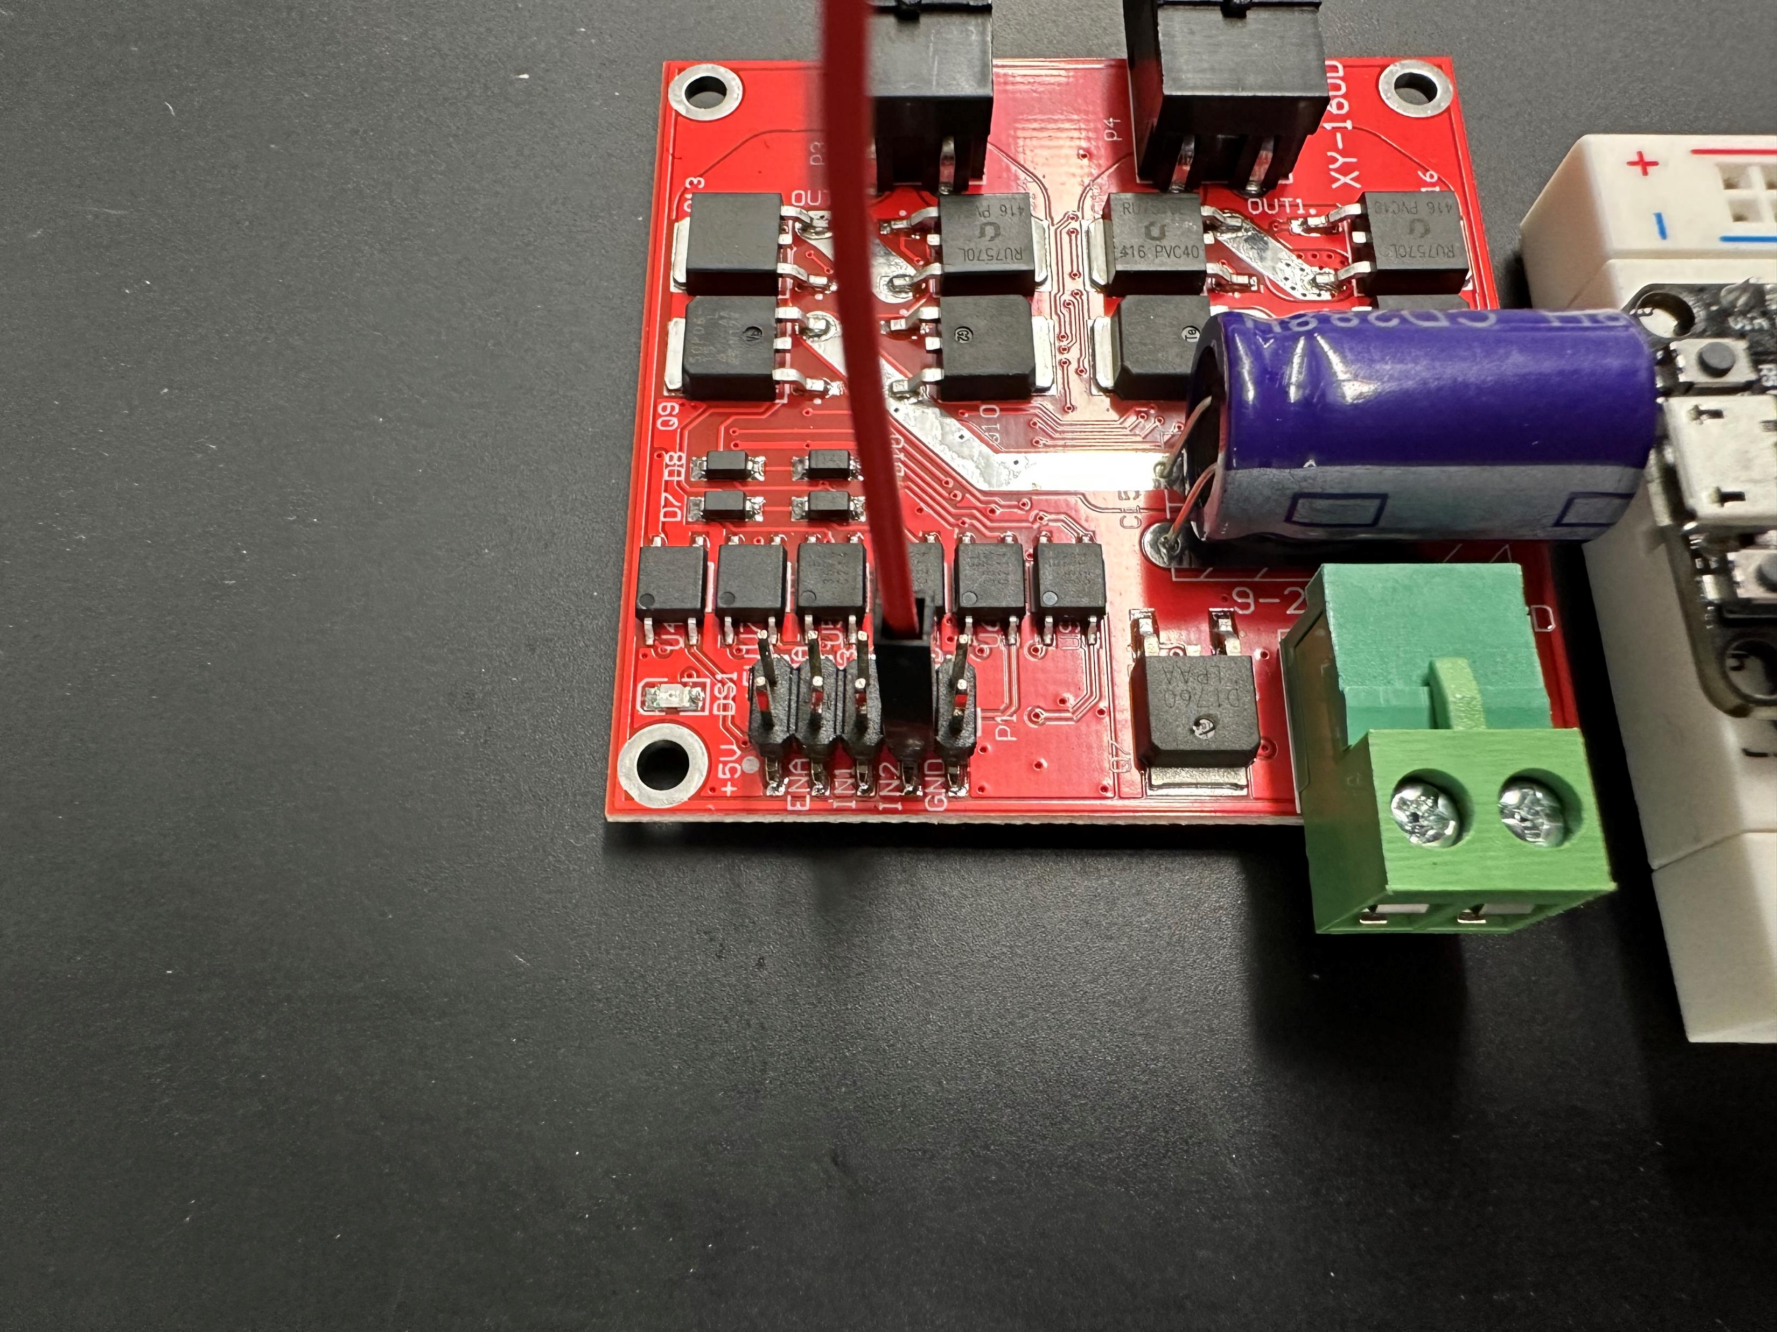
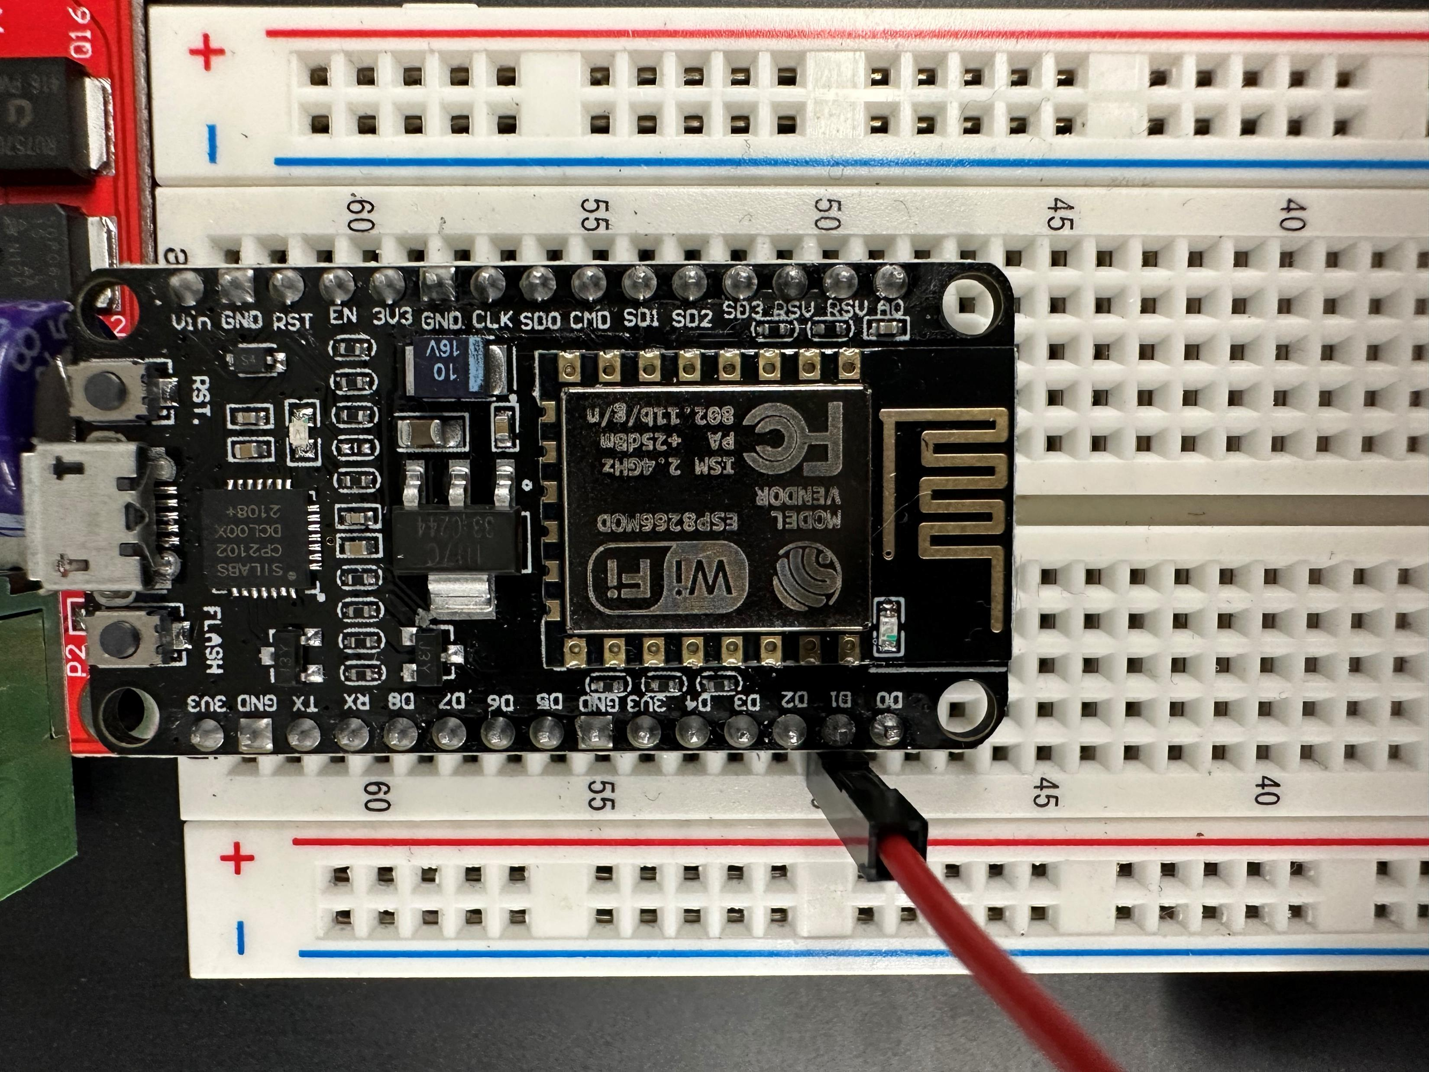
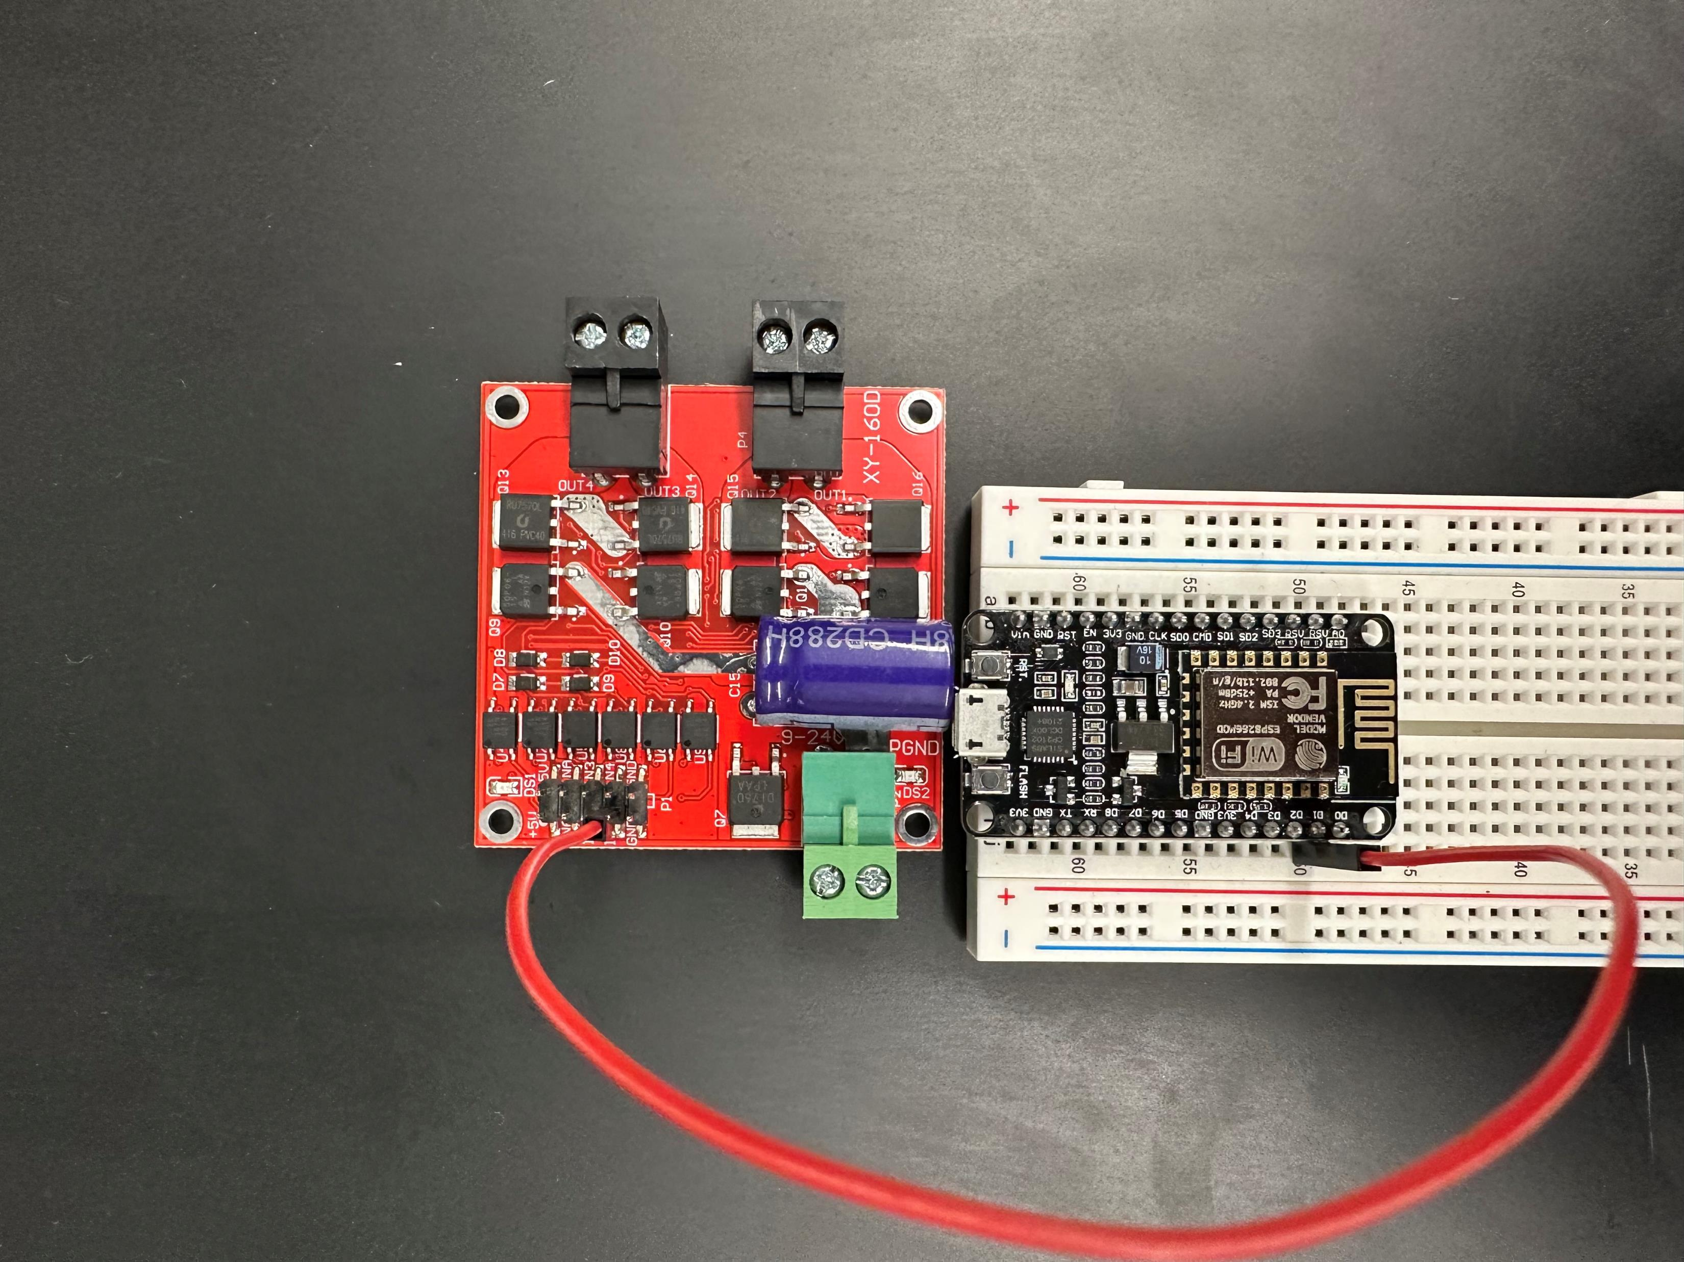
Pin D1 to IN2

Slide 21
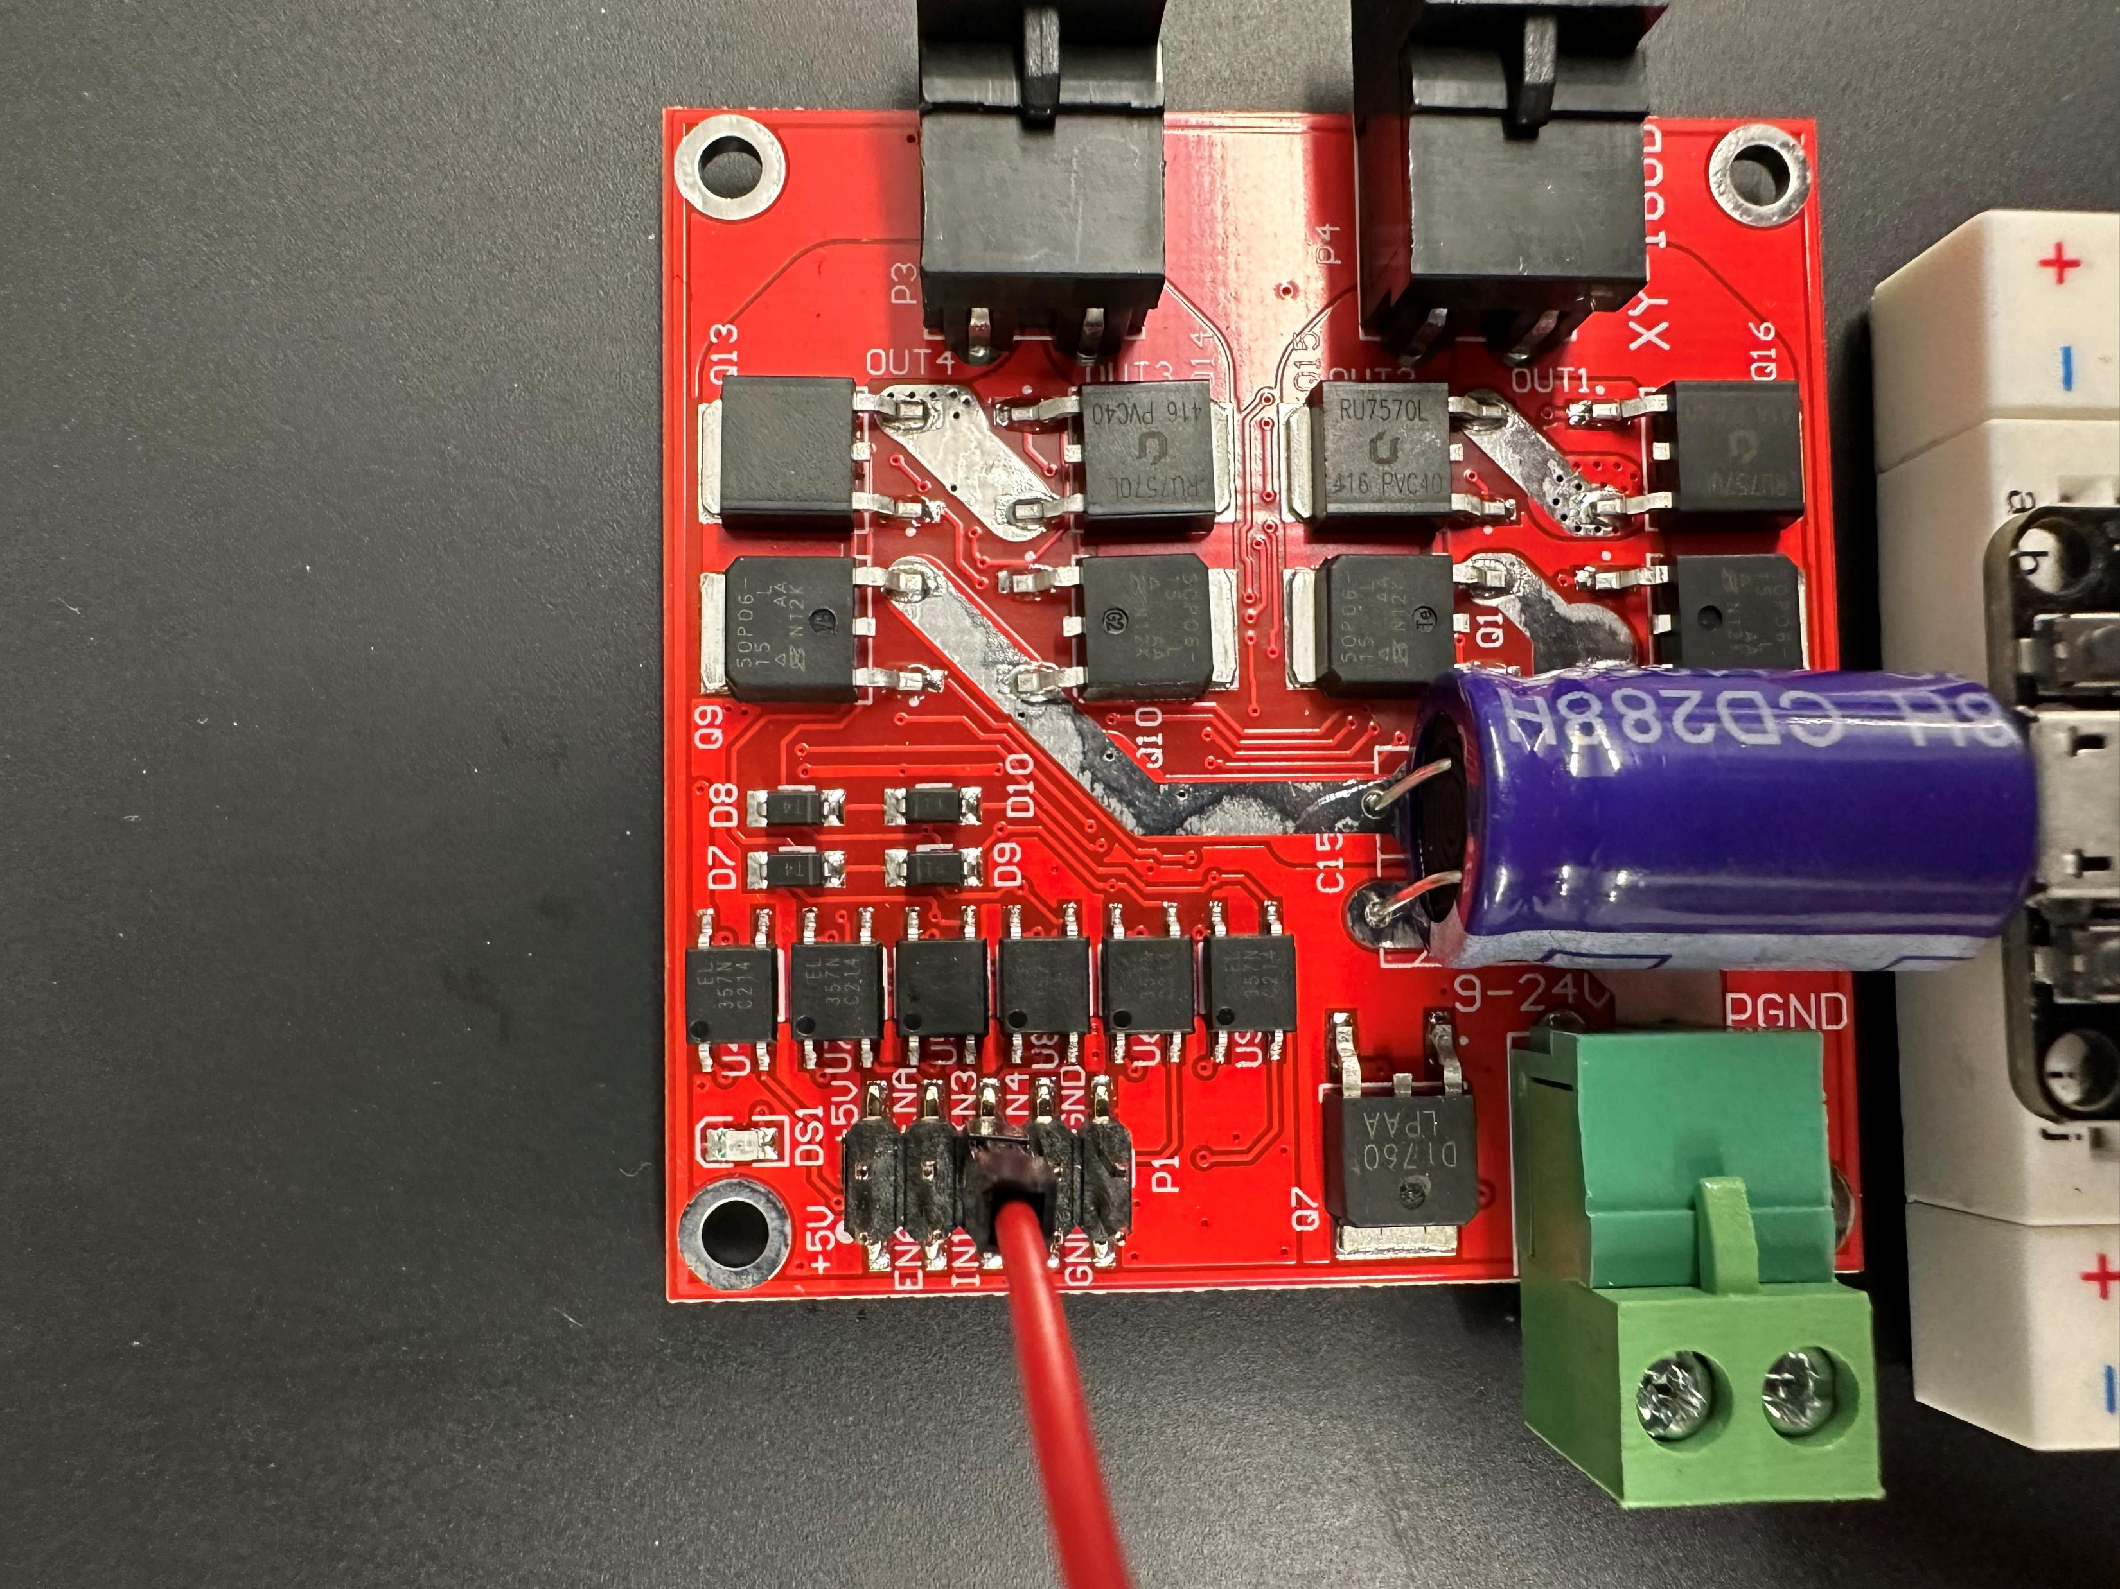
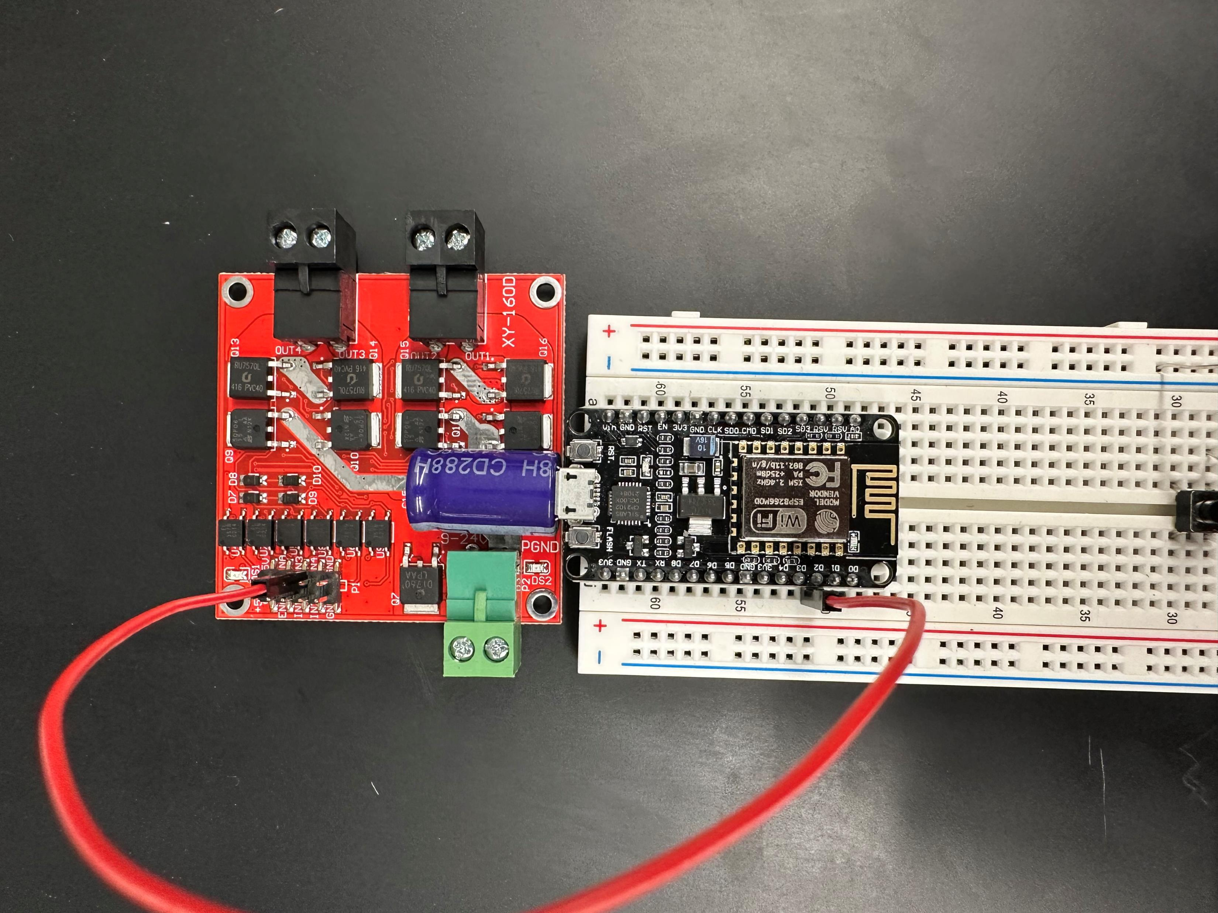
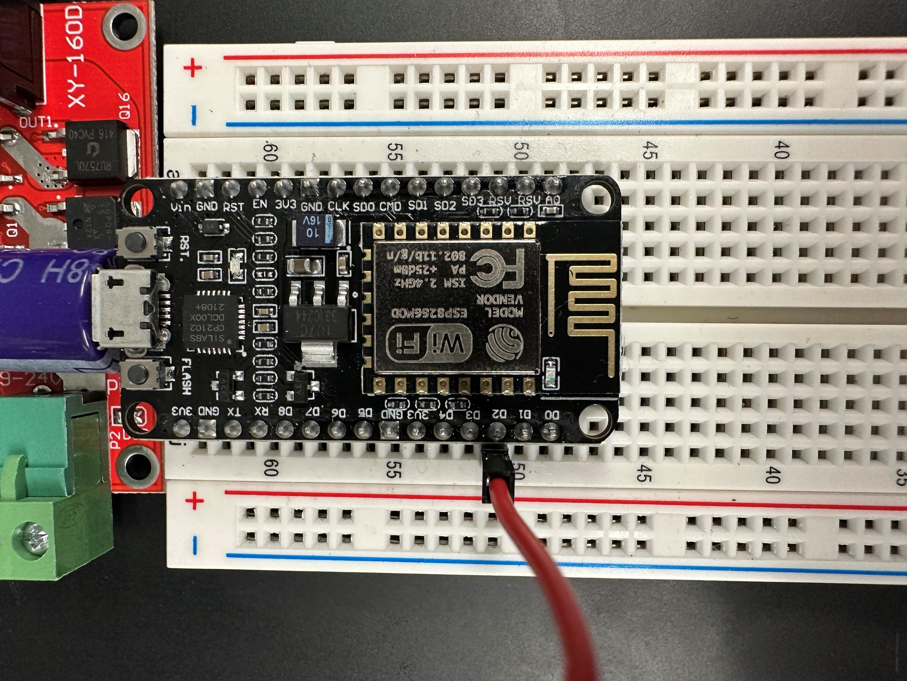
Pin D2 to IN3

Slide 22
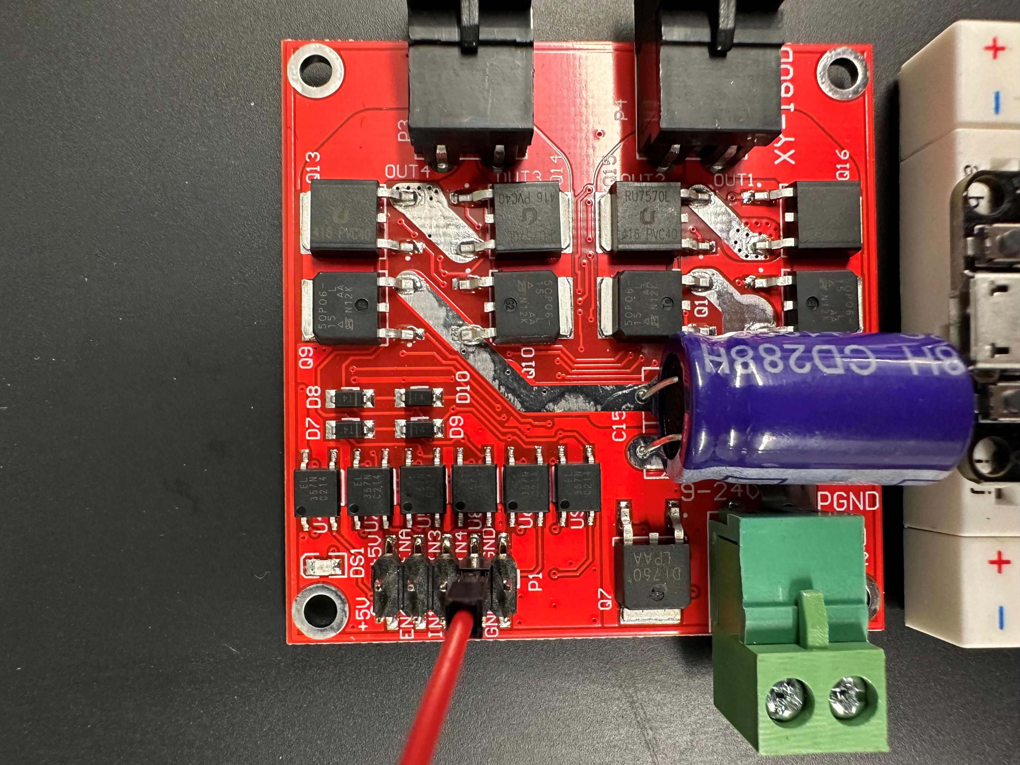
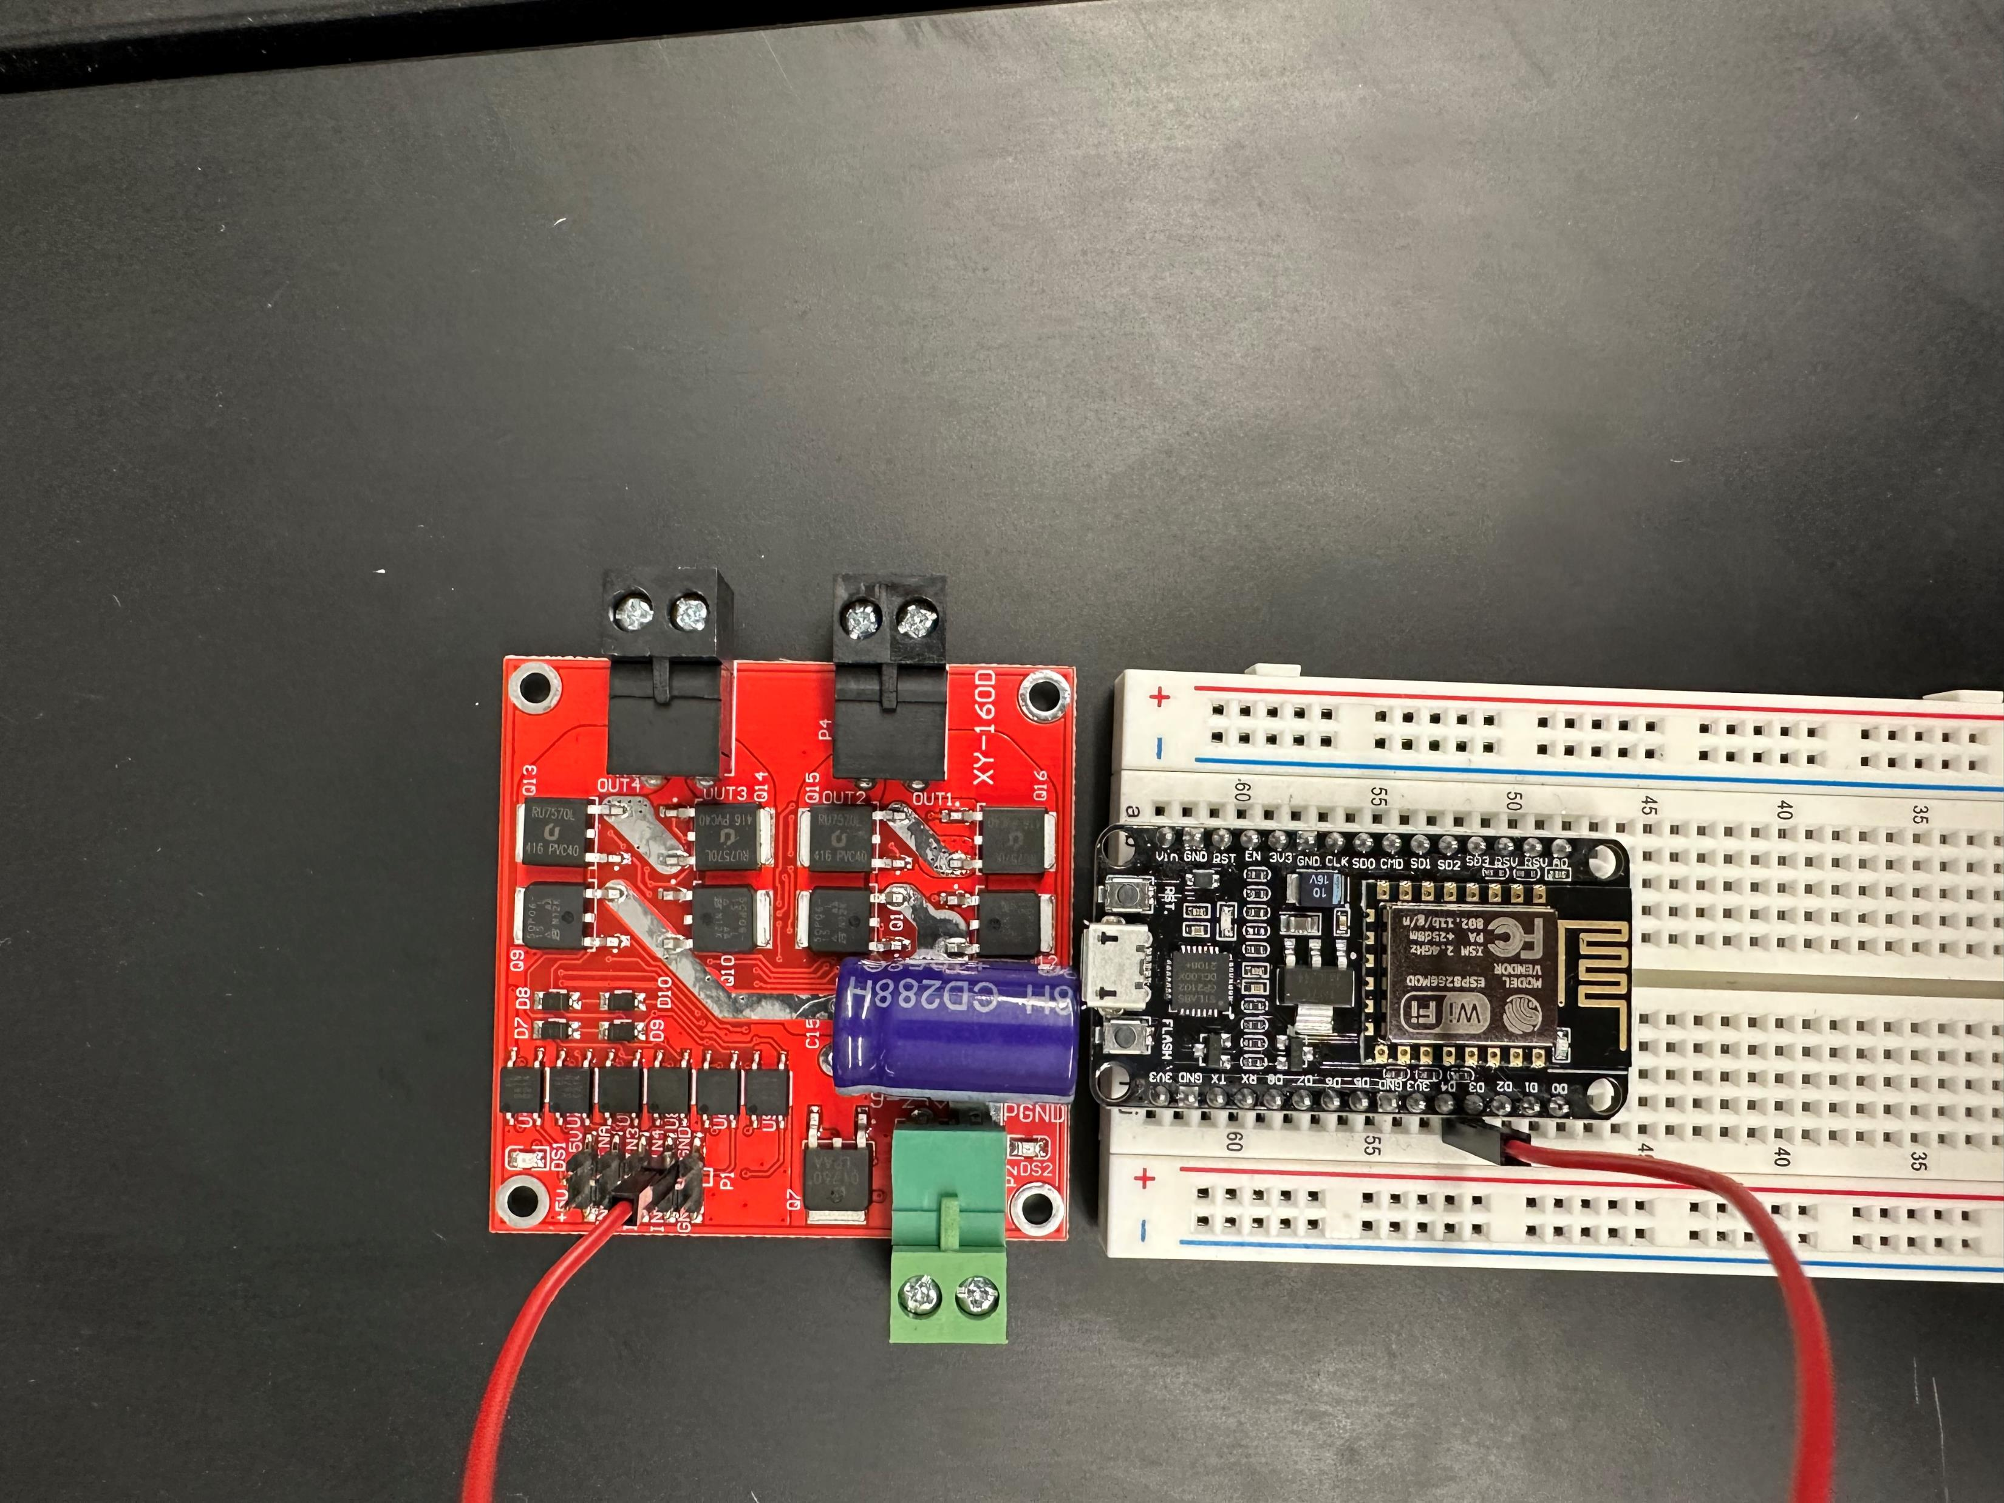
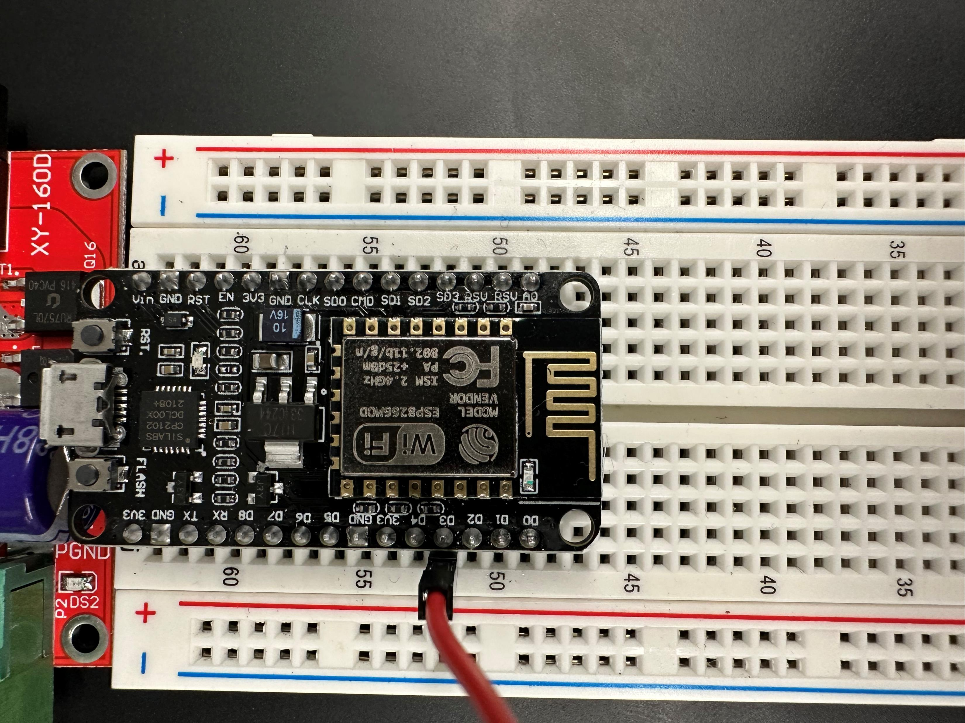
Pin D3 to IN4

Slide 23
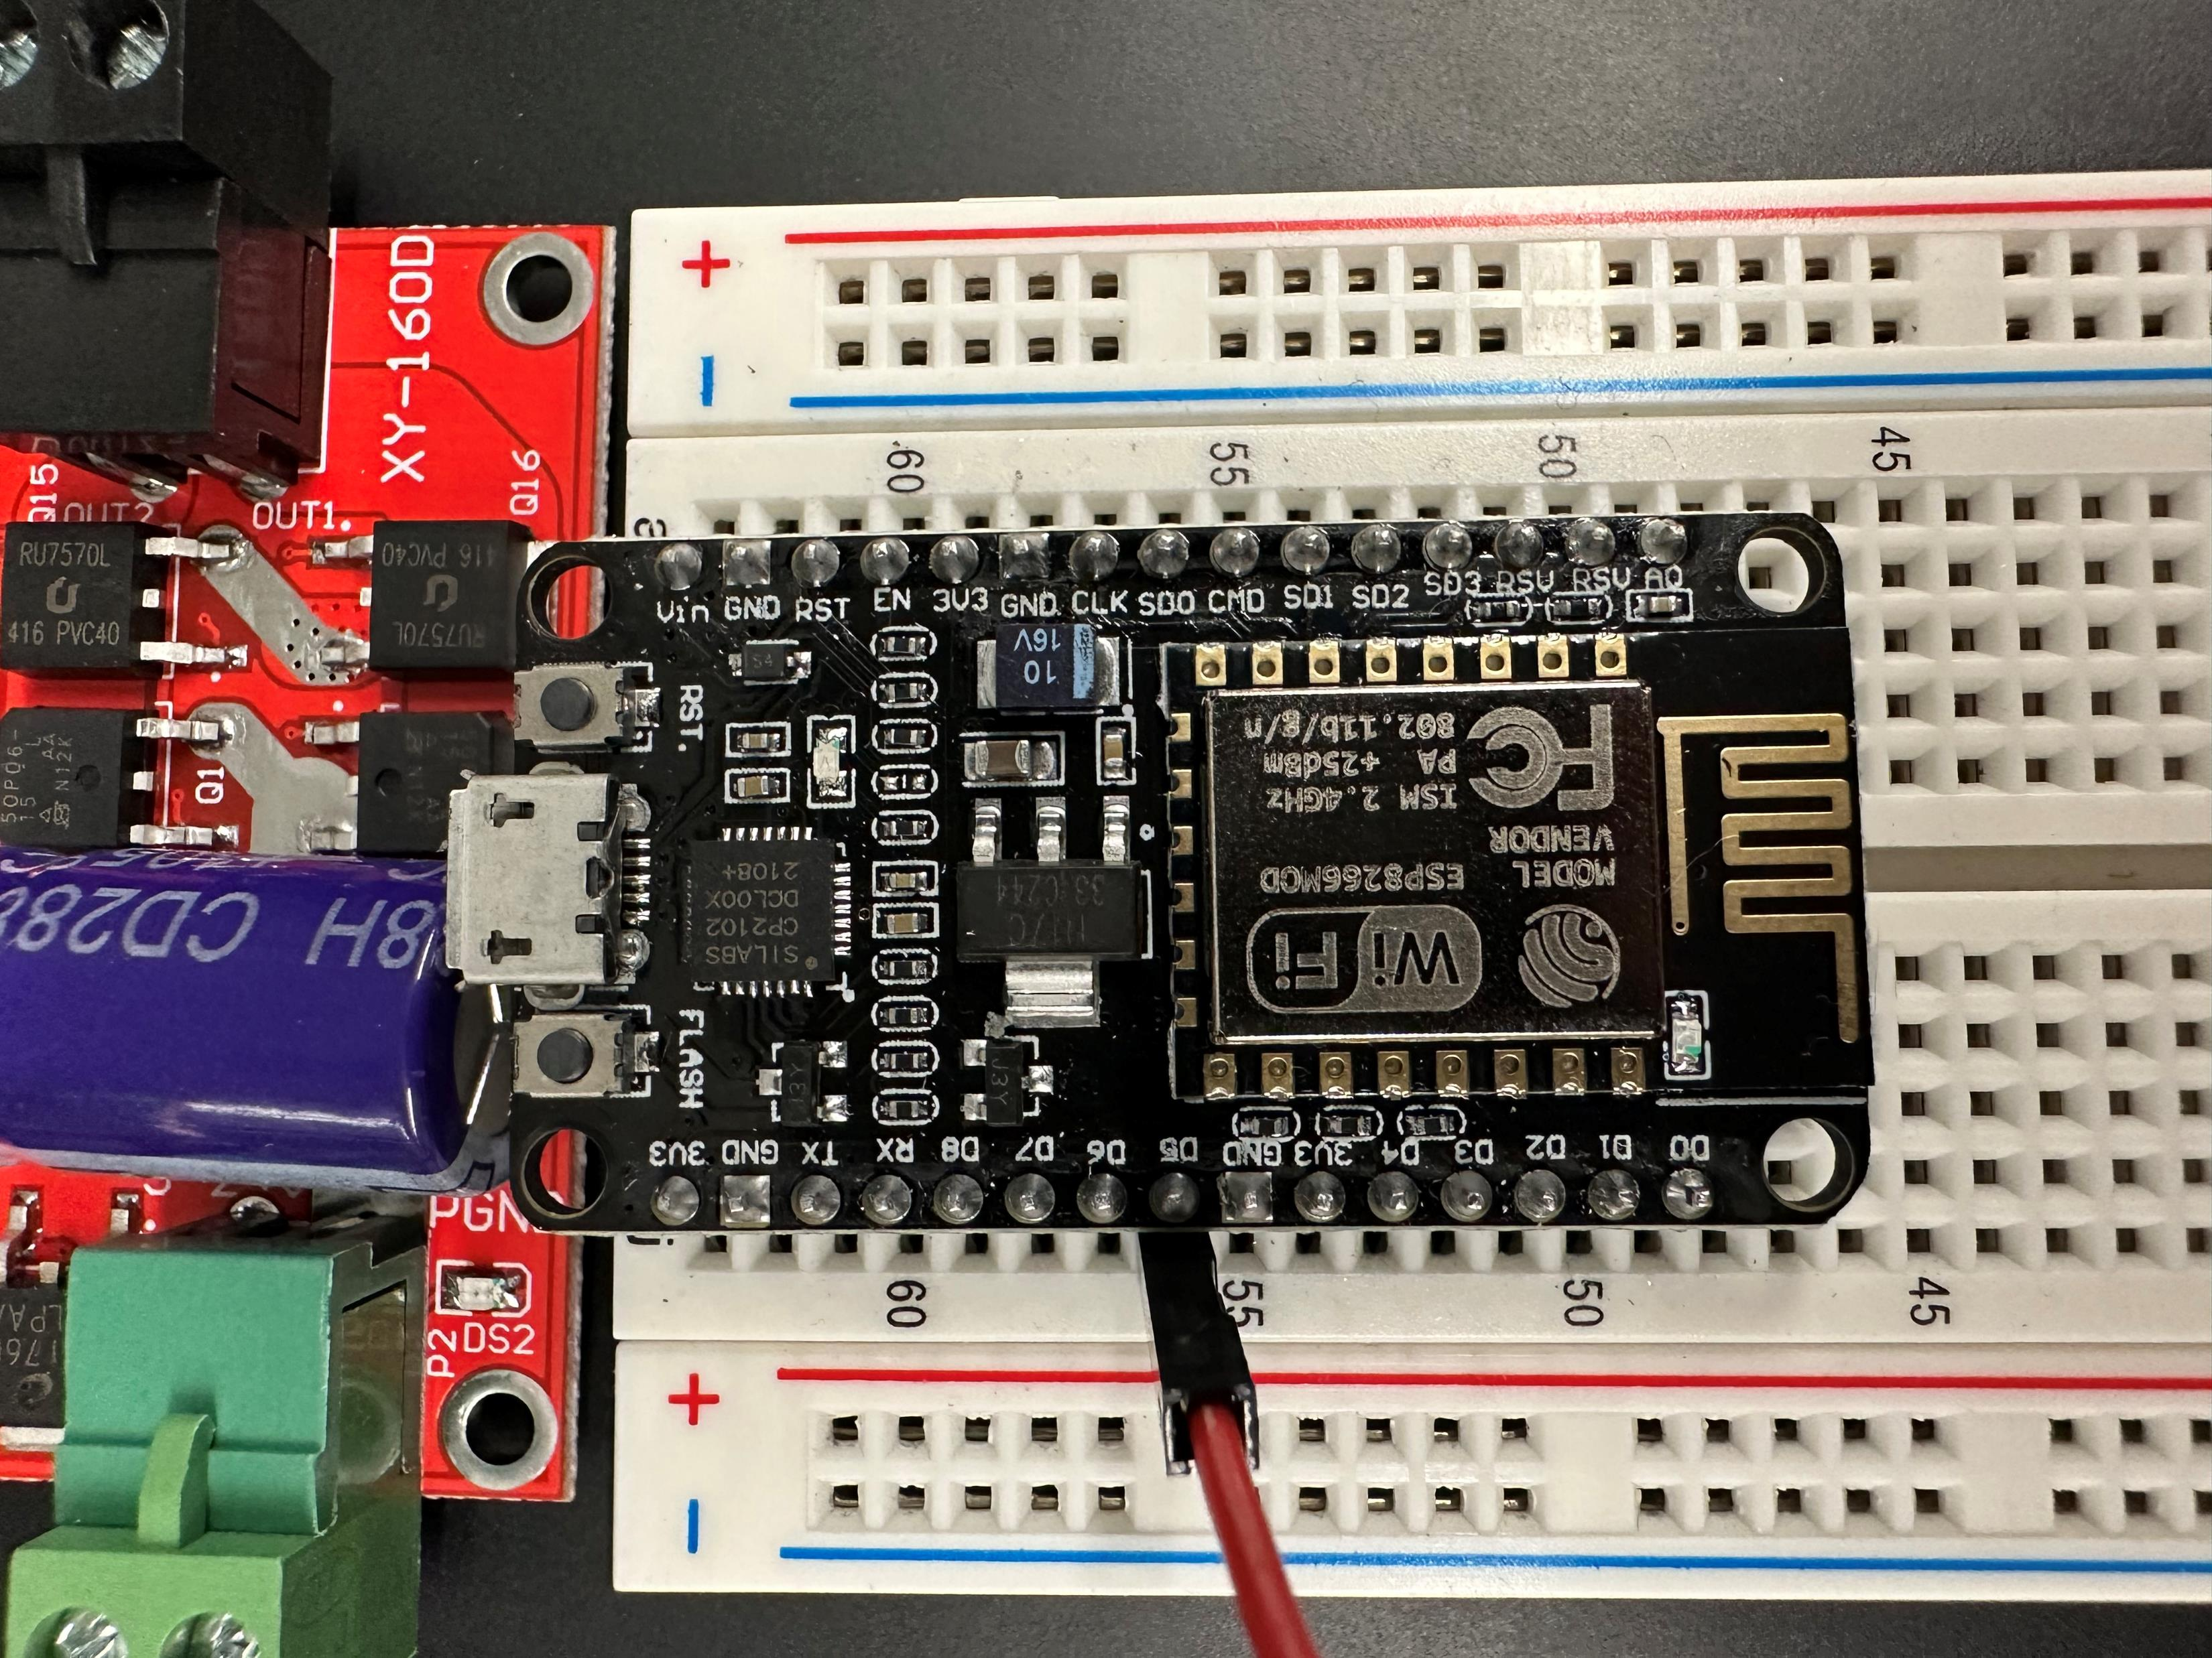
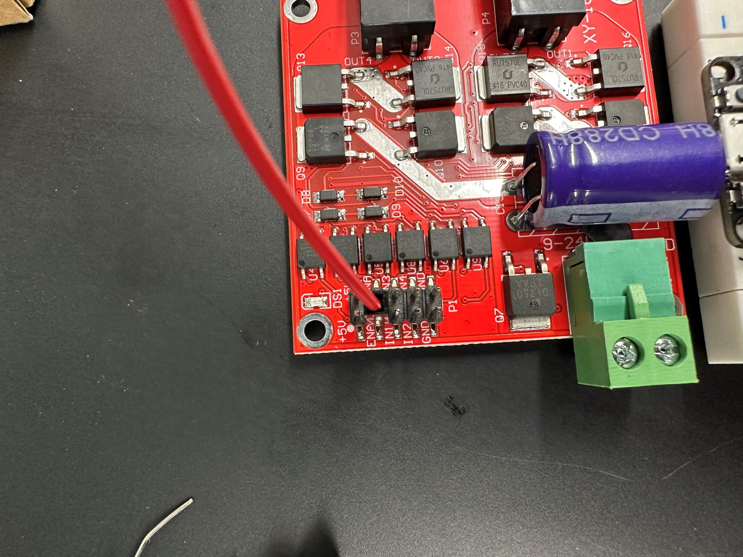
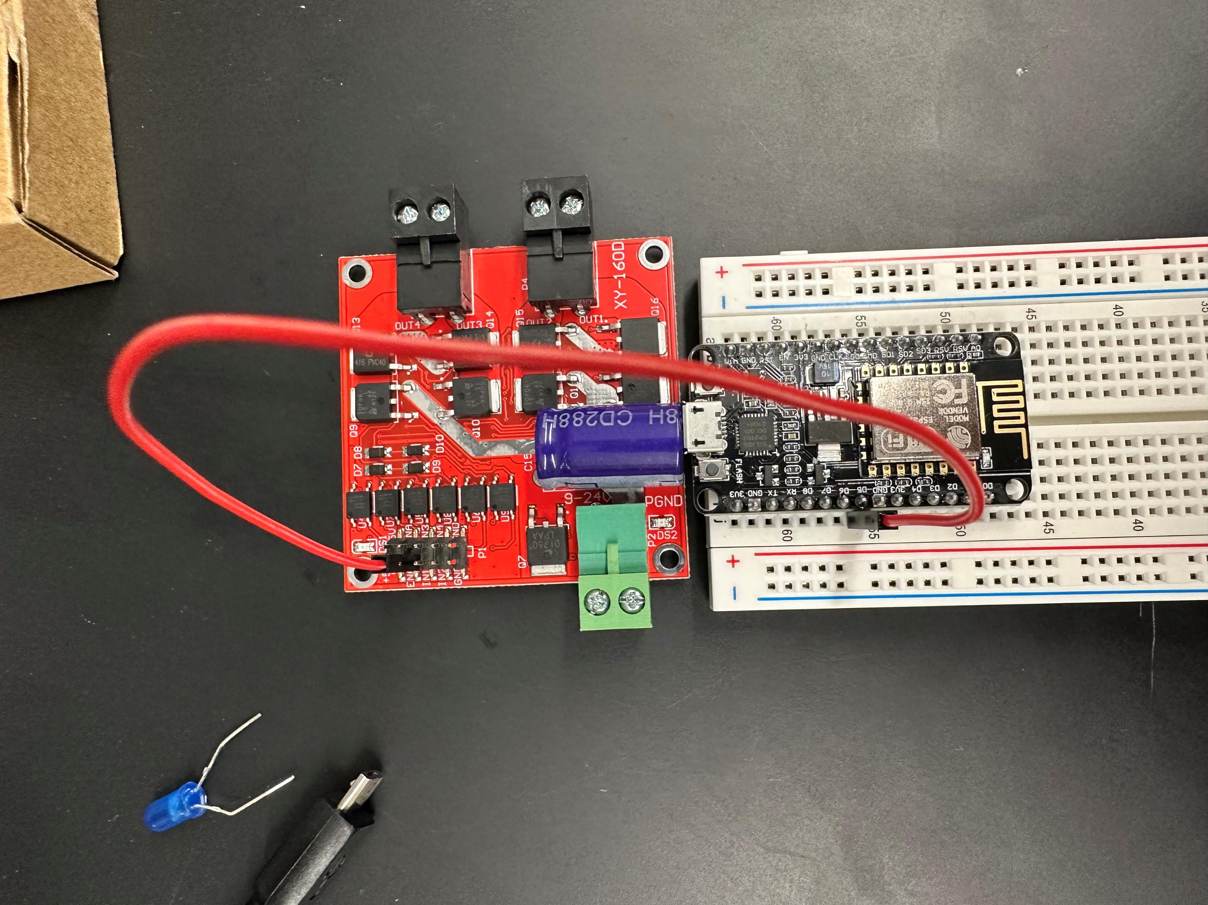
Pin D5 to ENA1 (left side)

Slide 24
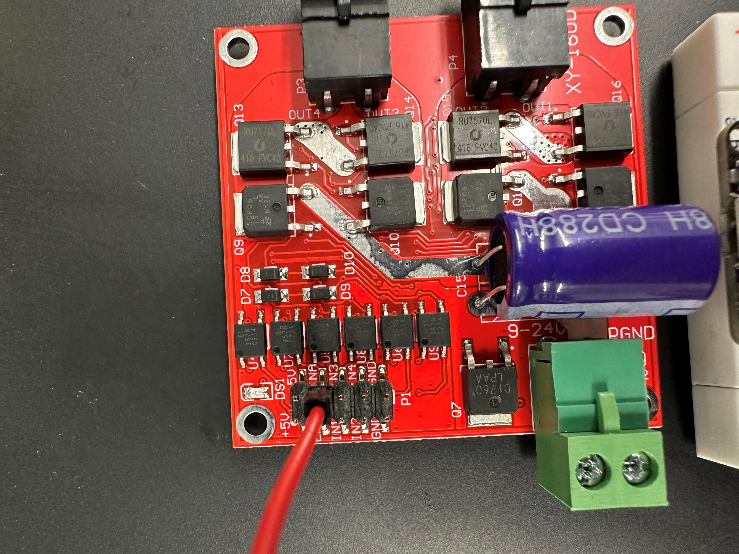
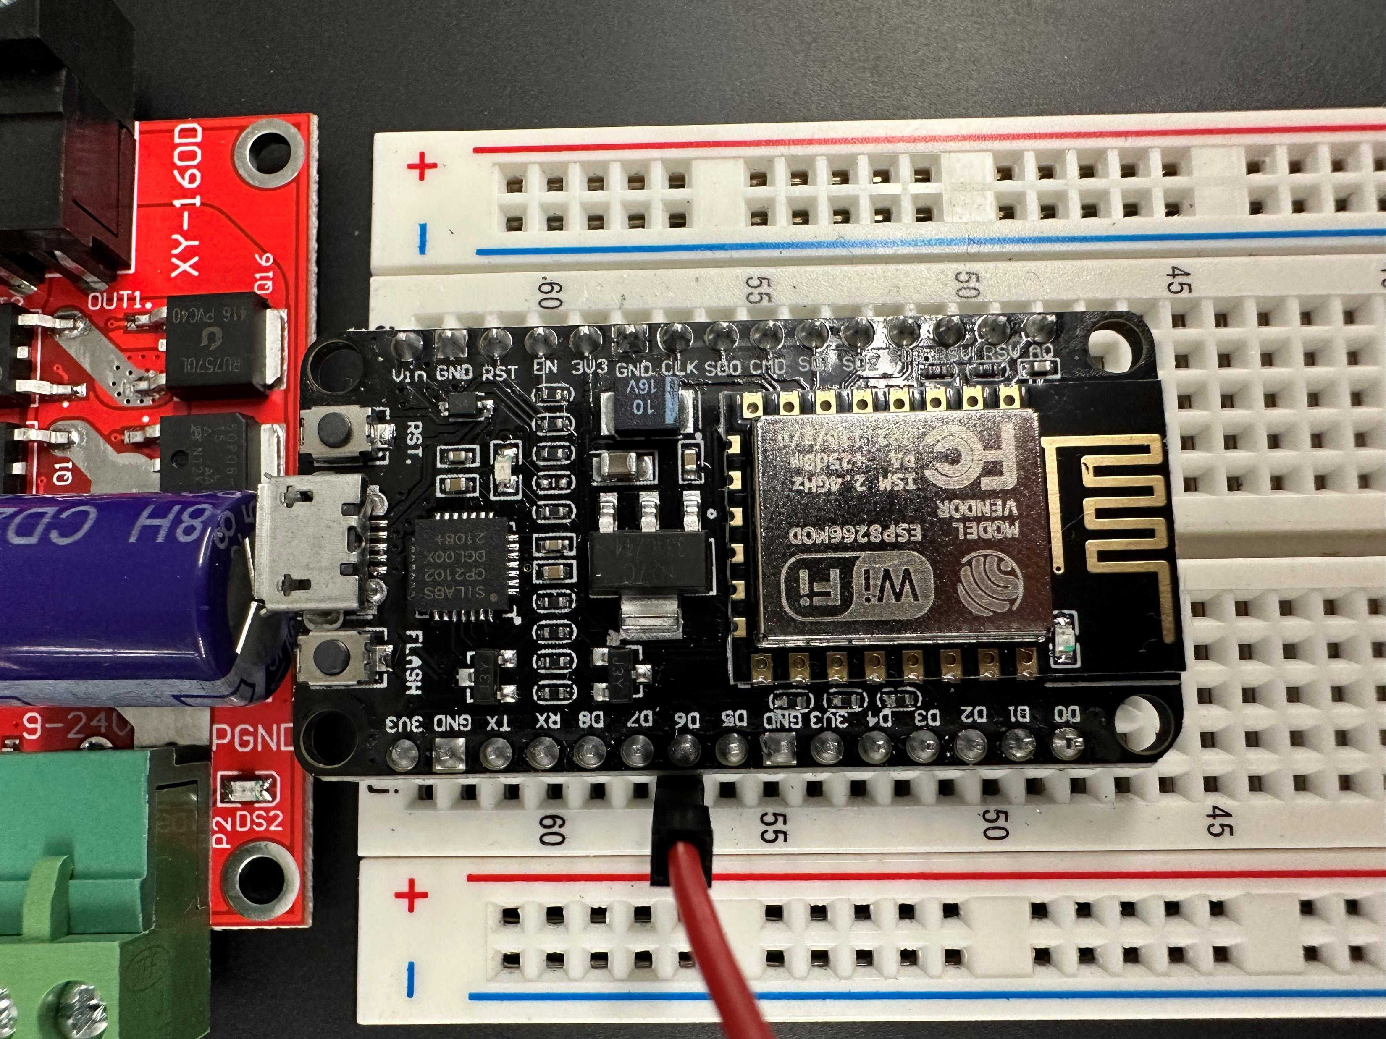
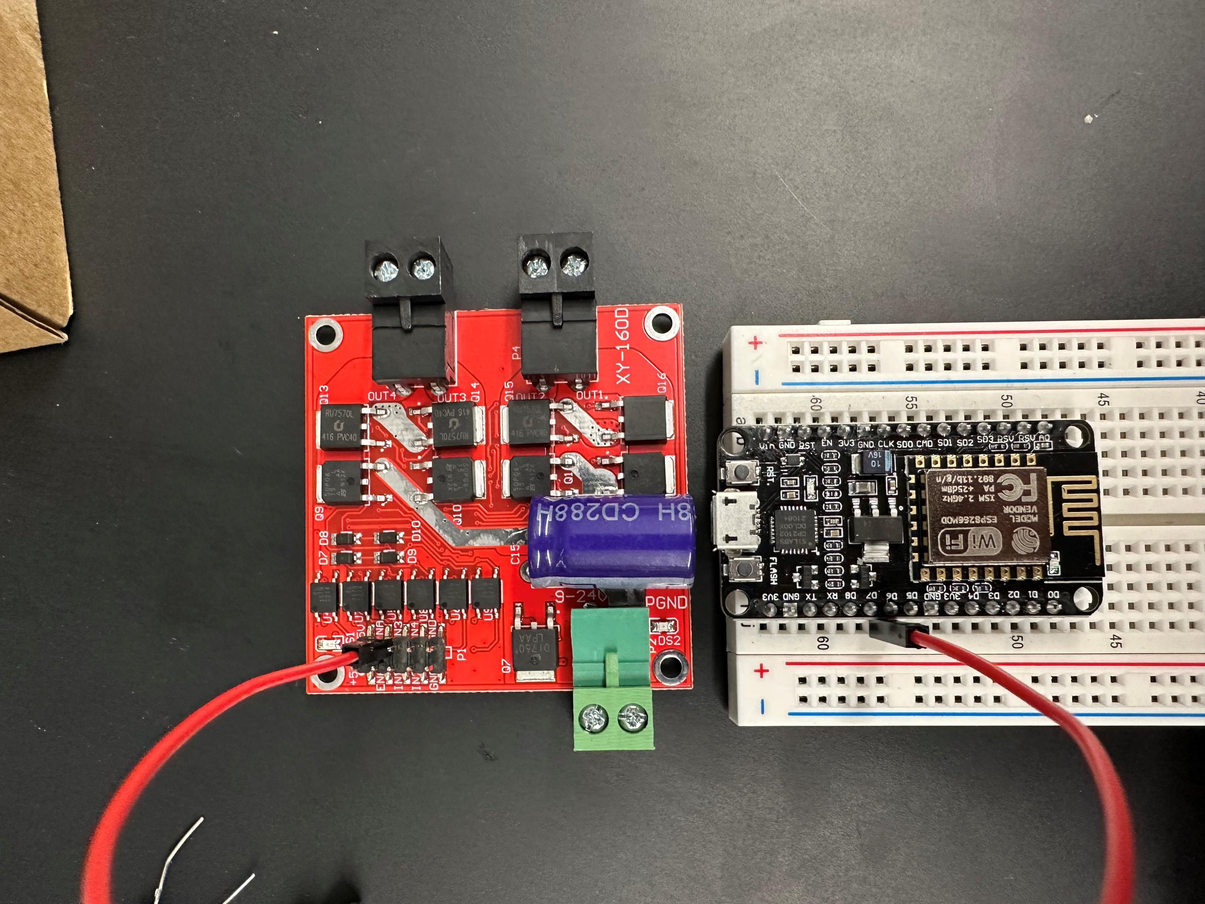
Pin D6 to ENA2 (right side)

Slide 25
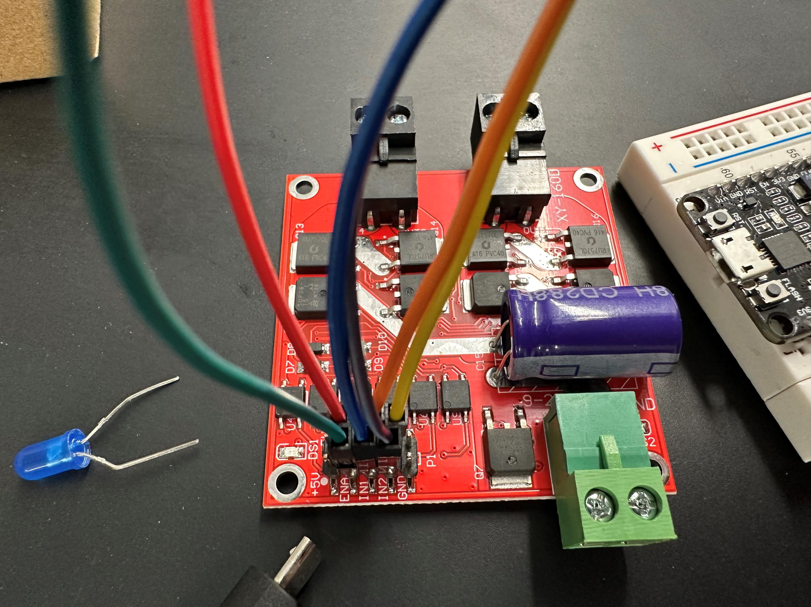
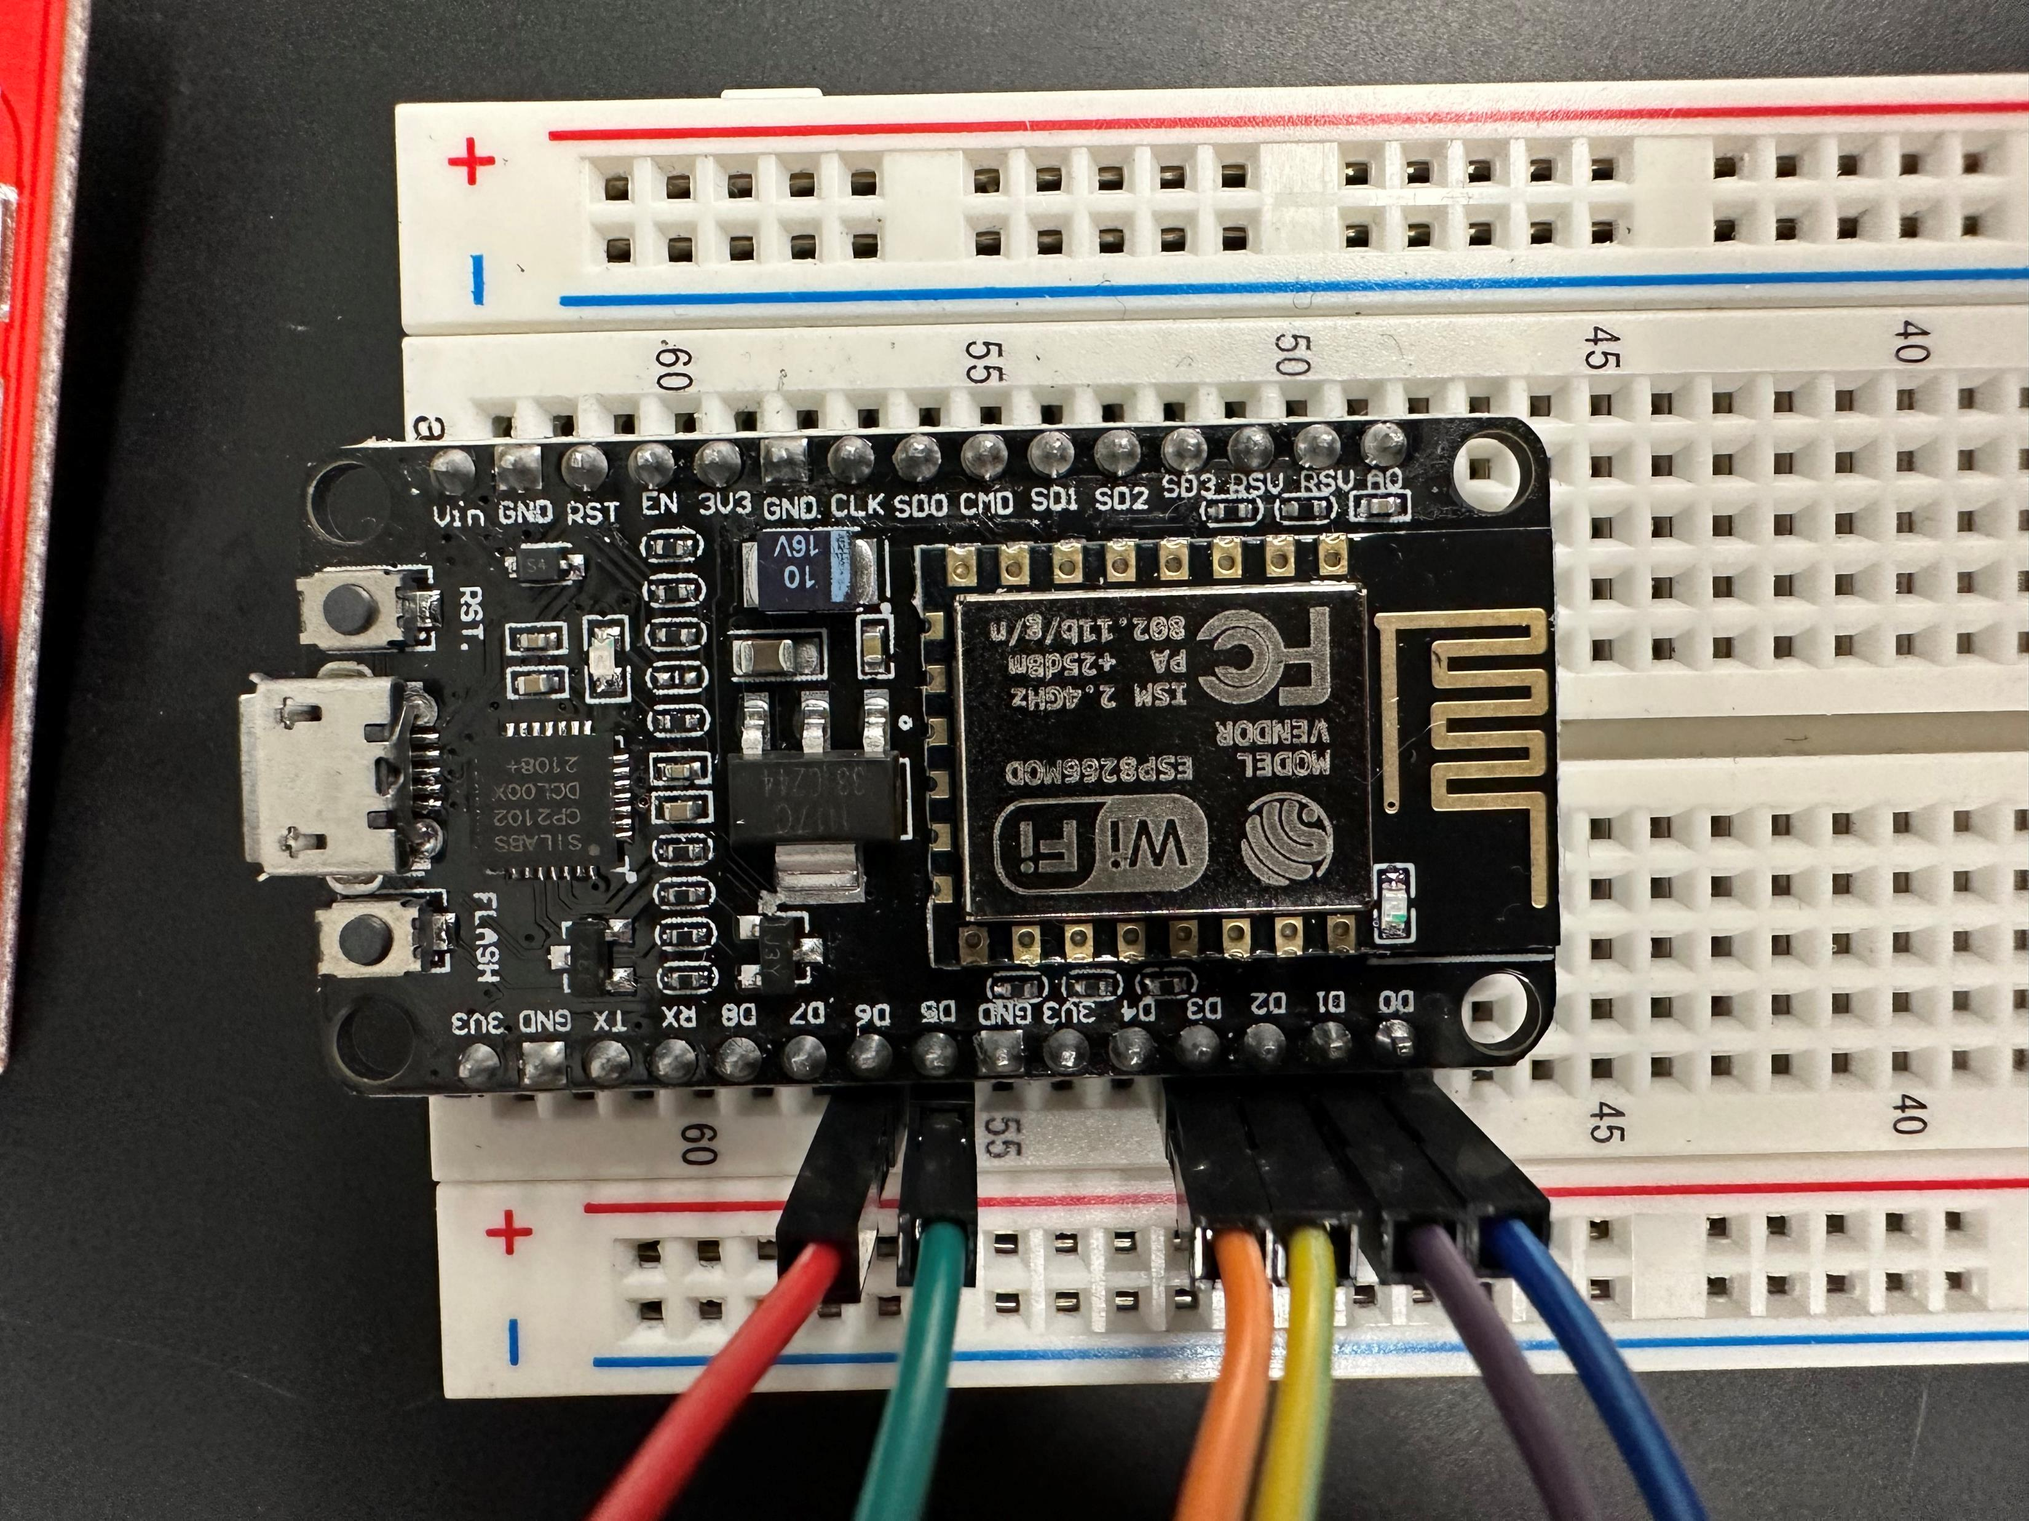
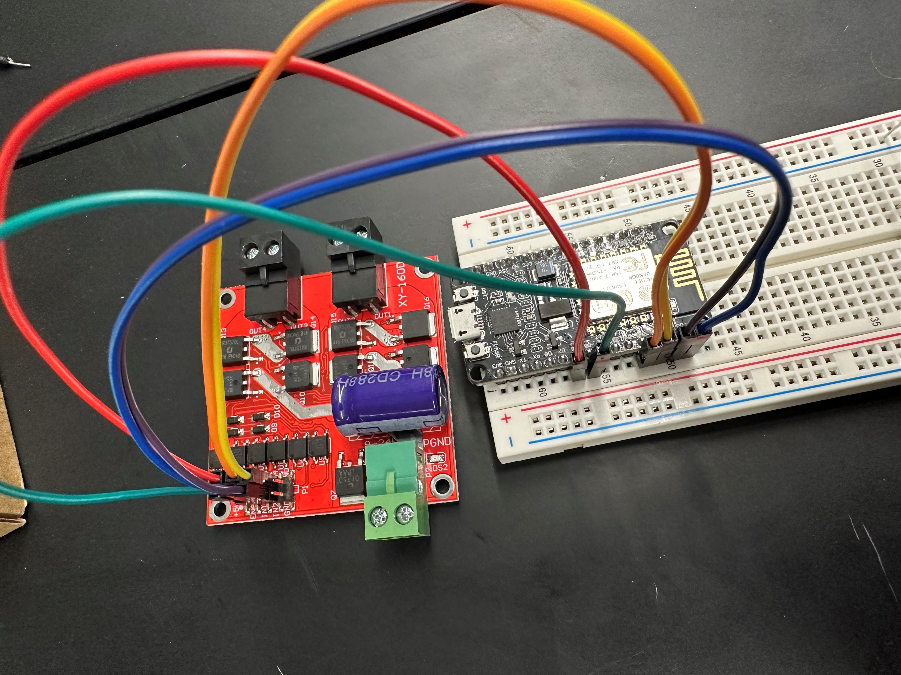
Pin – Motor Driver

Slide 26
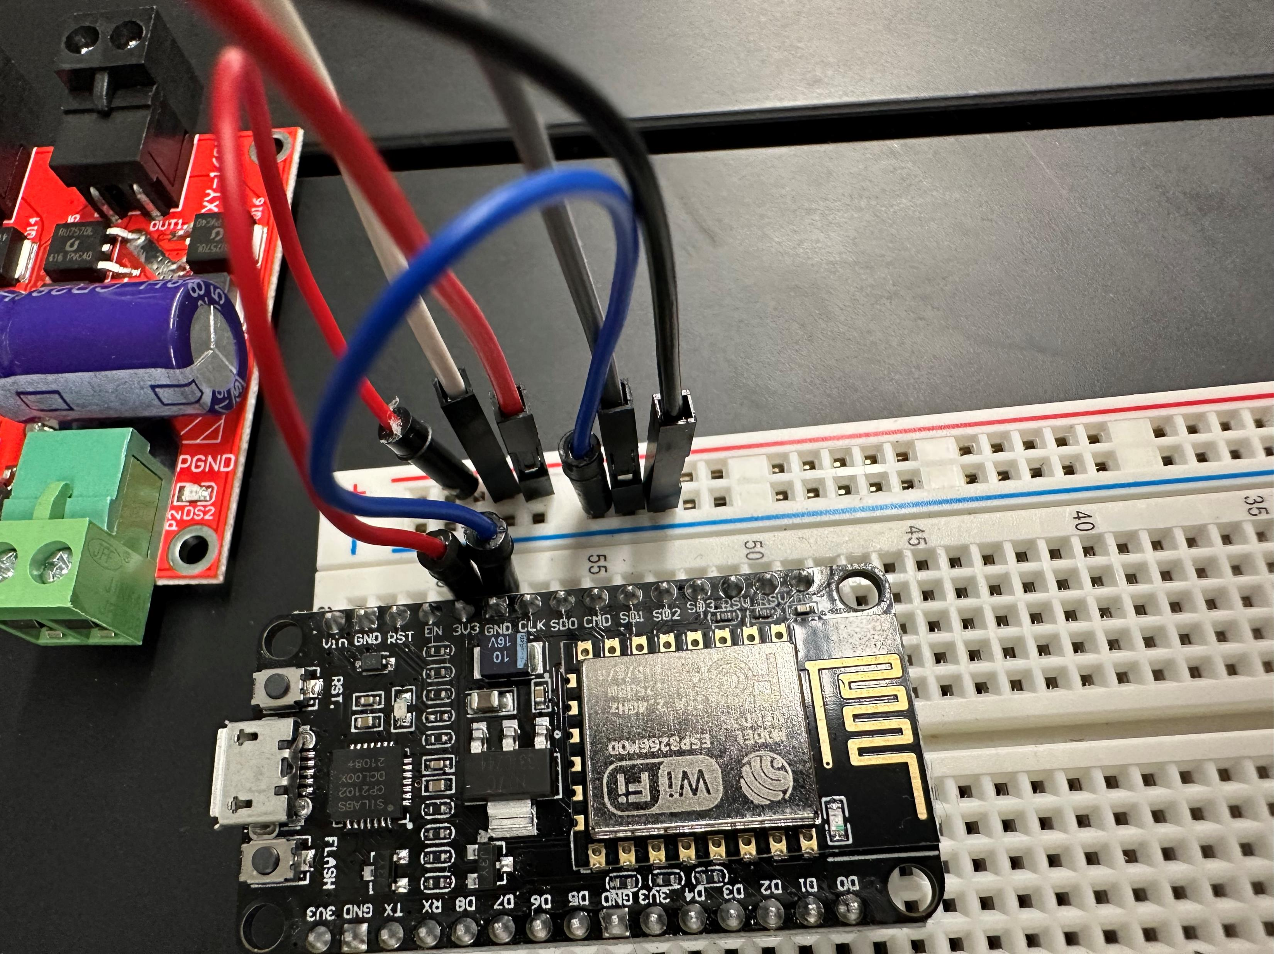
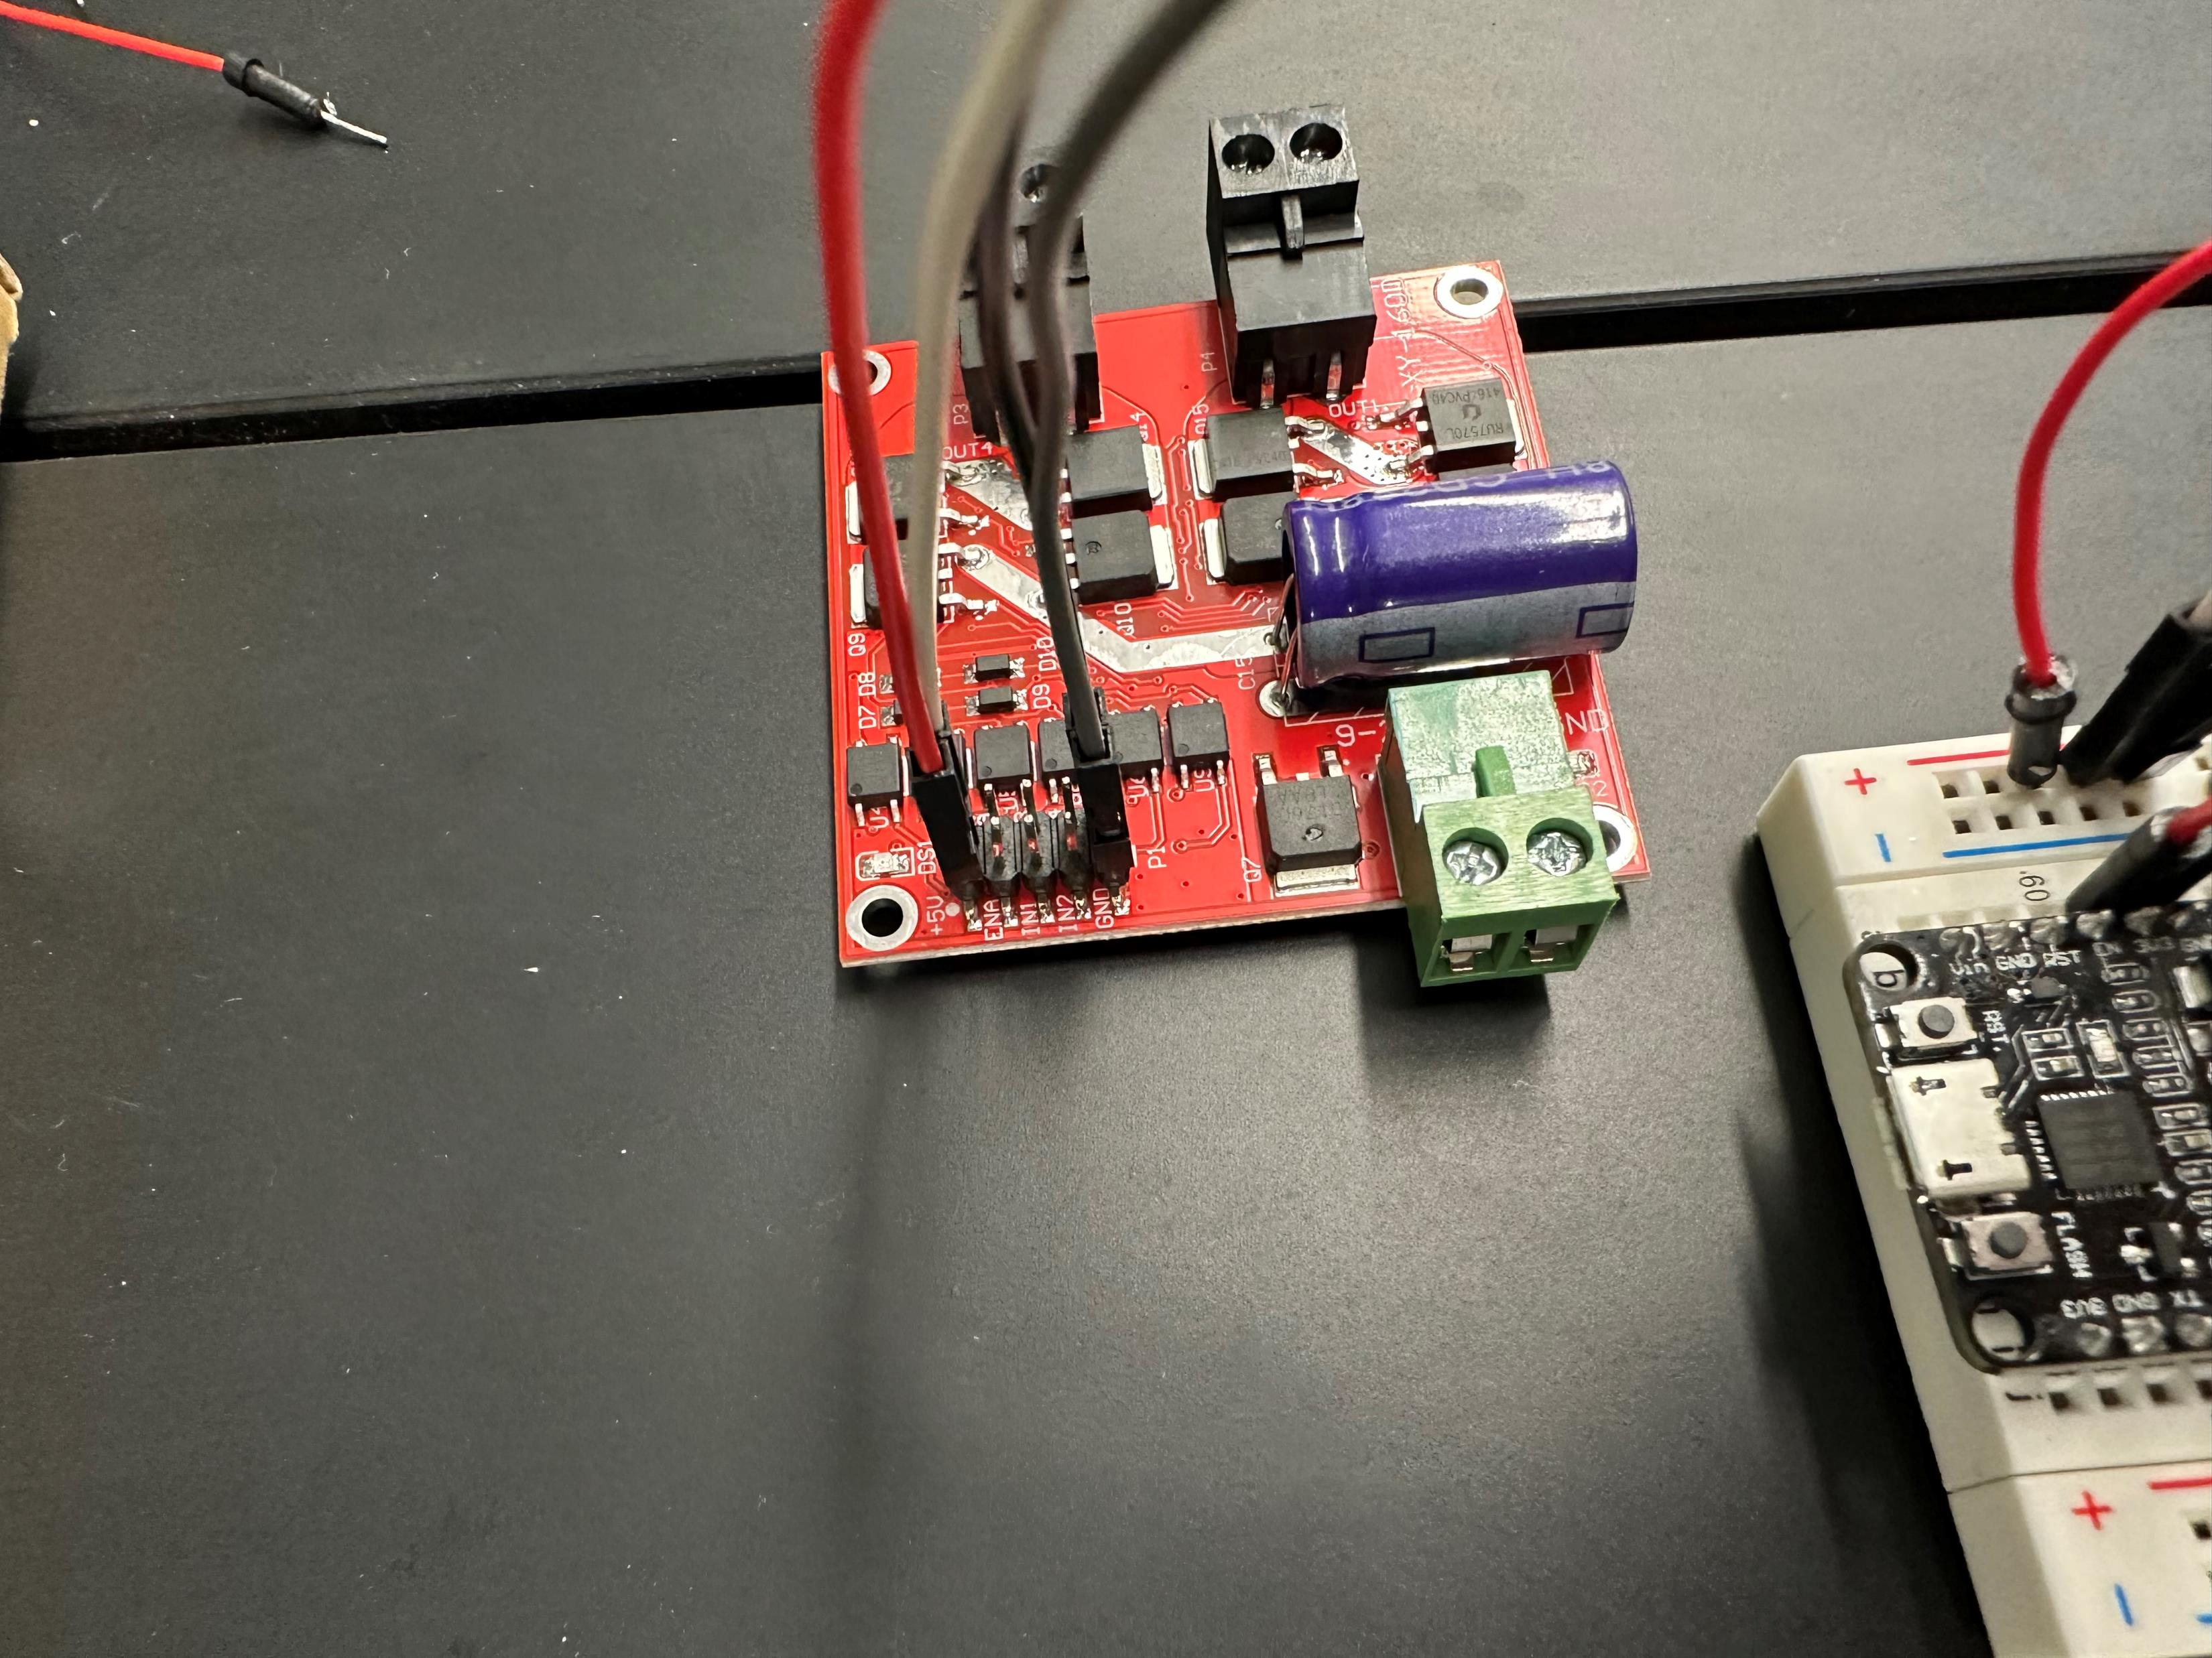
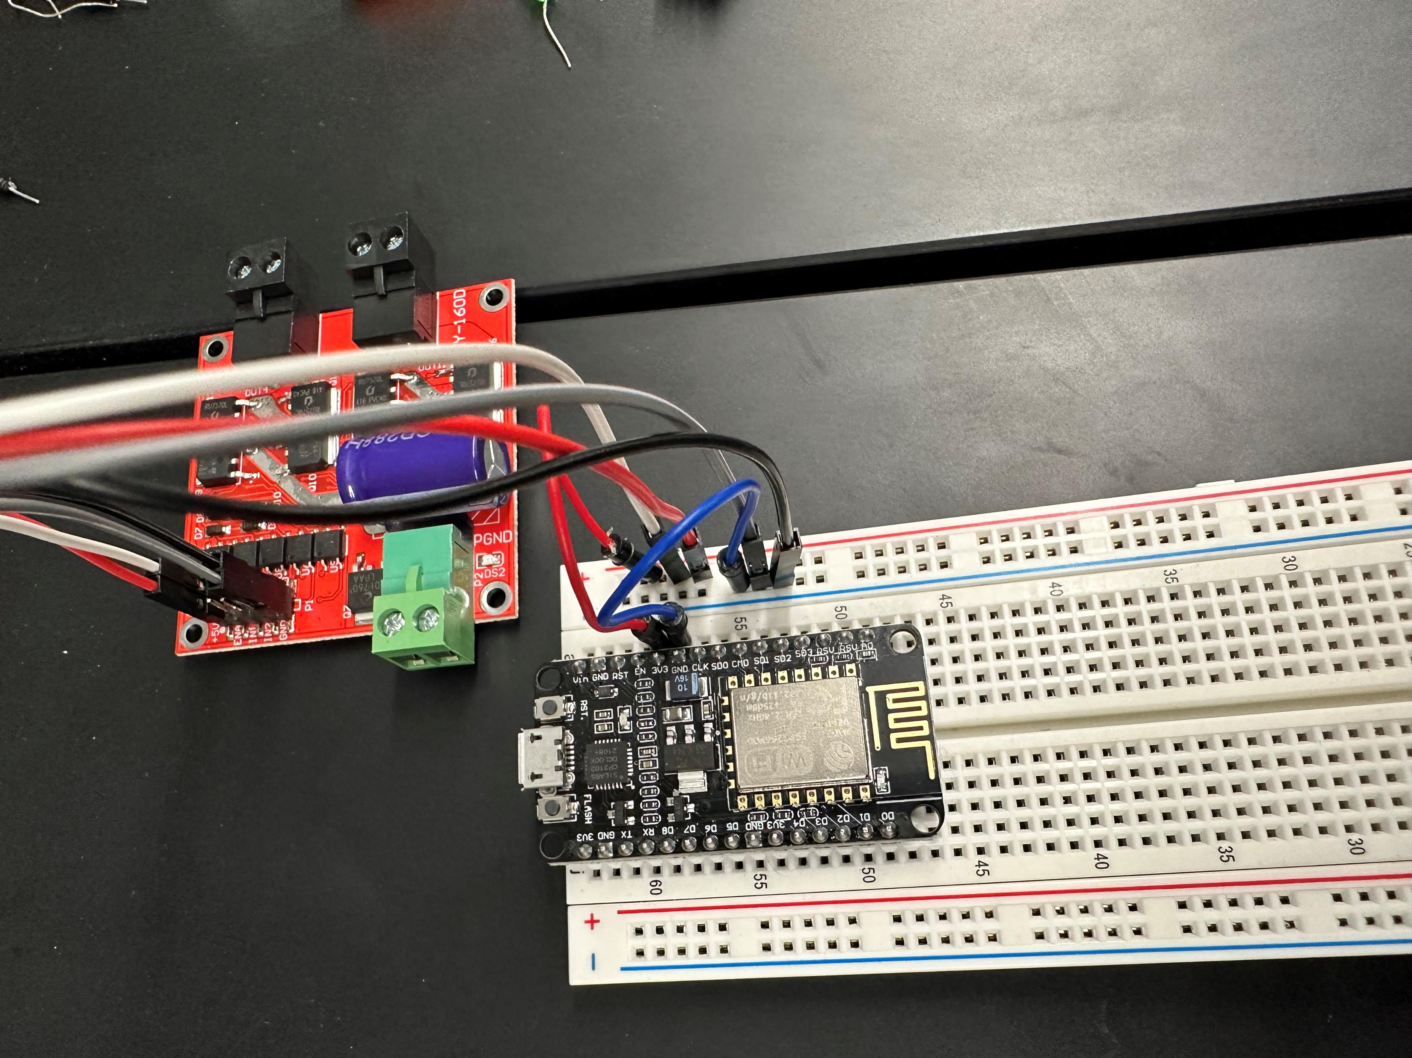
Power

Slide 27
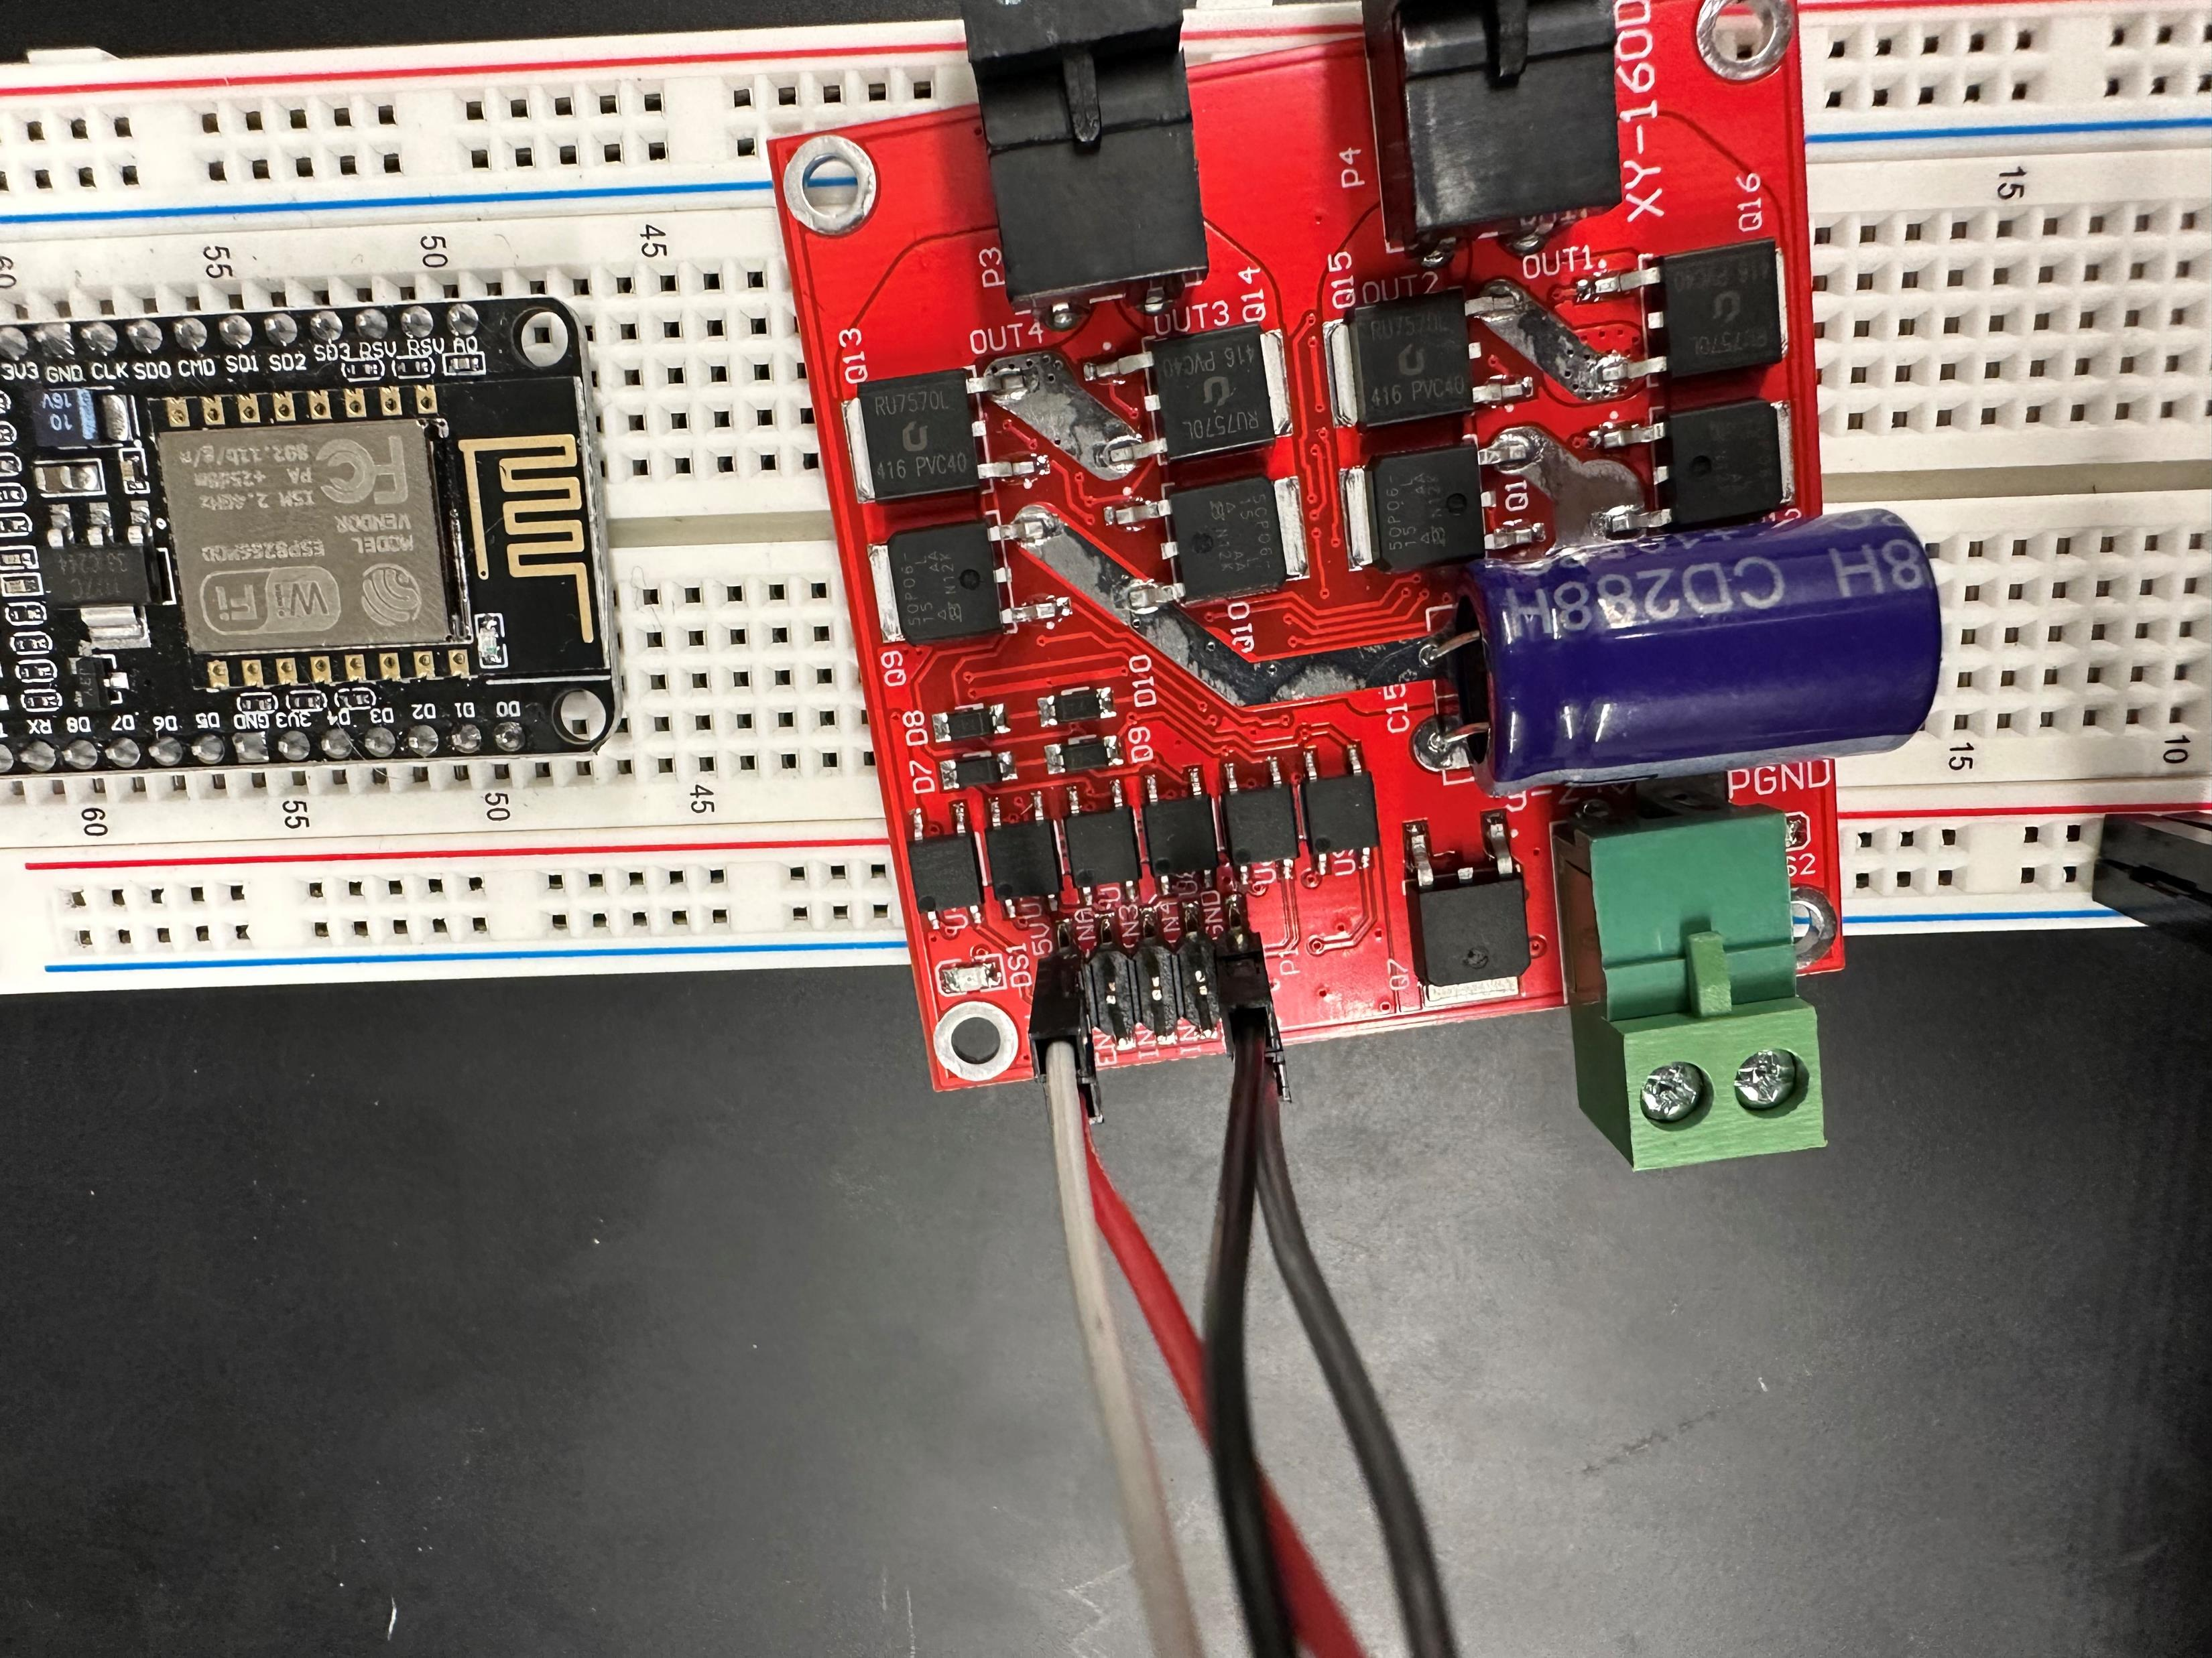
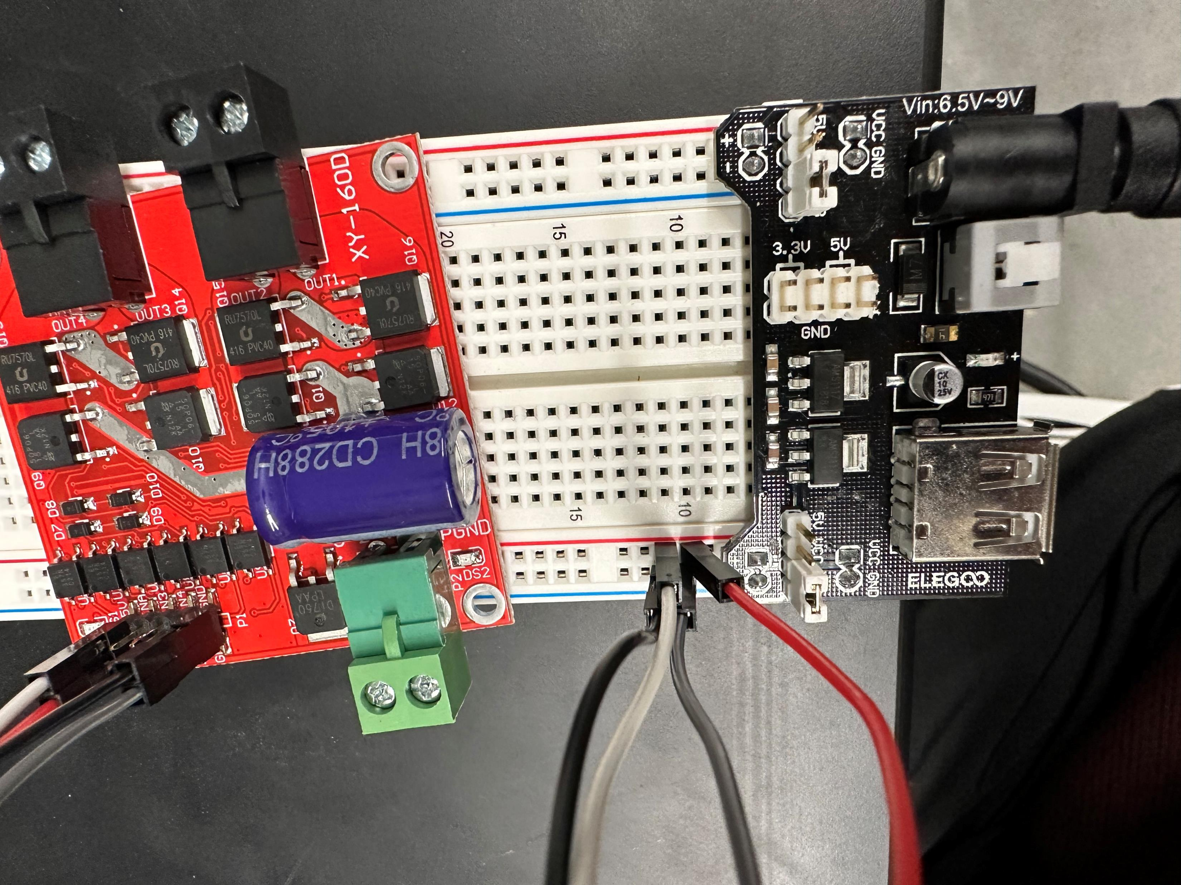

Arduino Power Supply Module

Slide 28
Programming the Arduino

Slide 29
Arduino IDE instillation and Libraries
Install Arduino IDE version 1.8.19 from https://www.arduino.cc/en/software
The provided code relies on some libraries to function correctly. To install the necessary libraries, go to "Sketch" -> "Include Library" -> "Manage Libraries" in the Arduino IDE menu. In the Library Manager, search for and install the following libraries:
"DHT sensor library" by Adafruit
"WiFi" by Arduino
“Firebase Arduino Client Library for ESP8266 and ESP32" by Mobizt

Slide 30
Configuring the IDE
Launch Arduino IDE
In the Arduino IDE, go to the "Tools" menu and select the appropriate board from the "Board" submenu. Choose “NodeMCU 1.0 (ESP-12E Module)
If you can’t find the board, go to “Tools” -> “Board” -> “Board Manager” and install “esp8266” by ESP8266 Community
In “Tools” -> "Port“, select the port to which your Arduino board is connected

Slide 31
Uploading sketches
Connect the Arduino to your computer
Click the upload arrow located in the top left of the IDE
If the upload fails, make sure the port is correct

Slide 32

Wi-fi Hotspot
Remove battery from hotspot
Hot environments are bad for the batteries
Plug in provided USB cable to hotspot and power brick
Plug power brick inside packout

Slide 33
Installation at Greenhouse

Slide 34


Removing Hardware
Remove the hex bolt connecting the chain to the curtain rod
A 13mm socket fit
Then remove the old chain from the carabiner

Slide 35

Removing curtain pole
Remove the old curtain rod from the creeper

Slide 36

Remove hex bolt
Remove the hex bolt and nut connecting the curtain rod to the creeper
11mm socket works

Slide 37


Assembling Motor
Attach the coupler that came with the motor to the motor. Line up the holes and fasten together with the short hex bolt that came in the box

Slide 38

Assembling Motor
Insert new creeper into motor
Use the long bolt and nut provided in the motor hardware bag to fasten them together

Slide 39

Assembling Motor
Coupling adapter
Pilot hole of 3/32”
Stepped up to 3/16”
Actual is 1/4"

Slide 40

Drilling coupler adapter to curtain rod
Insert the coupler into the curtain rod
Drill pilot holes to line up with the existing curtain rod holes
Drill out hole to fit hardware that was previously there

Slide 41

Attaching new rod
Attach the creeper rod to the motor

Slide 42


Attach to chains
Drill a thru hole near the top of the creeper pole so that it can attach to the chains and bolt
Reuse hardware to attach new creeper pole to the new chains

Slide 43

Motor Wiring
Feed motor wire under the curtain to the packout

Slide 44
Mirror setup for other side of greenhouse

Slide 45
Motor wiring
Measure wire to go from the Packout, then to feed up and around the front door to the opposite side of the greenhouse where the other motor would go. Add a few feet in length. Cut and Feed wire through the corner like previously done. Strip the wire and then add it to the snap connector. Feed in the motor wires to the other side of the snap connector. Secure the wire going up and around the door with zip ties

Slide 46



Slide 47
Temperature Sensors

Slide 48


Connecting temperature sensors
Connect the provided female ends to the pins on the sensor
Wrap in electrical tape
Insert male end to snap connector

Slide 49


Connecting sensor reel wire
Strip the reel of wire and connect to snap connector
Red=positive
Yellow=data
Black=ground

Slide 50

Sensor cable length
Unroll cable until proper sensor location is determined
Fasten sensor to electrical pipe via zip ties
Do NOT over tighten zip tie around sensor
Wire sensor back to the Arduino through the grommets on Packout

Slide 51
Setting Mechanical Limits on Motors

Slide 52

Lower Limit
When the motor is in the desired down position, open the orange door on the motor
Push the red knob in and twist it until the white arrow is at 0
This sets a mechanical limit to the motor so it does not go down too far
NOTE: AFTER SETTING THE DOWN POSITION TO 0, THE MOTOR WILL BE ABLE TO SPIN DOWN FOR ABOUT ONE ROTATION. IT IS RECOMMENED TO SET THE 0 POSITION SLIGHTLY BEFORE THE TRUE “DOWN” POSITION

Slide 53

Upper Limit
When the motor is in the desired up position, open the orange door on the motor
Push the green knob in and twist it until the white arrow is at 0
This sets a mechanical limit to the motor so it does not go down too up
NOTE: AFTER SETTING THE UP POSITION TO 0, THE MOTOR WILL BE ABLE TO SPIN DOWN FOR ABOUT ONE ROTATION. IT IS RECOMMENED TO SET THE 0 POSITION SLIGHTLY BEFORE THE TRUE “UP” POSITION

